Slide 1
Software and systems engineering
Paulo Borba
Informatics Center
Federal University of Pernambuco
pauloborba.cin.ufpe.br

Slide 2
To do before class
Watch videos
Read chapters 8 and 11 in the textbook
Send questions and opinions through slack

Slide 3
Software and systems engineering
Paulo Borba
Informatics Center
Federal University of Pernambuco
pauloborba.cin.ufpe.br

Slide 4
Design, implementation, and maintenance 1
Notes:
45 minutos, com folga, no quadro! em slides seria mais rápido ainda. puxar mais assunto para cá? mais exemplos? 1:15 de roteiro, até a questão 4.

Slide 5
Software and systems engineering
Paulo Borba
Informatics Center
Federal University of Pernambuco
pauloborba.cin.ufpe.br
Notes:
assumindo que já levantamos, documentamos e validamos alguns requisitos, precisamos agora implementar o sistema. mas antes de implementar, é importante entender…

Slide 6
Which tools do we have for designing a system?
Notes:
sem realizar essa atividade, começando prematuramente a implementação, podemos ter desperdício, retrabalho, e insatisfação. em particular, precisamos entender…

Slide 7
What are the main concepts and how do they relate?
How the system implementation will be structured?
Notes:
mas, no momento, a única ideia que temos é…

Slide 8
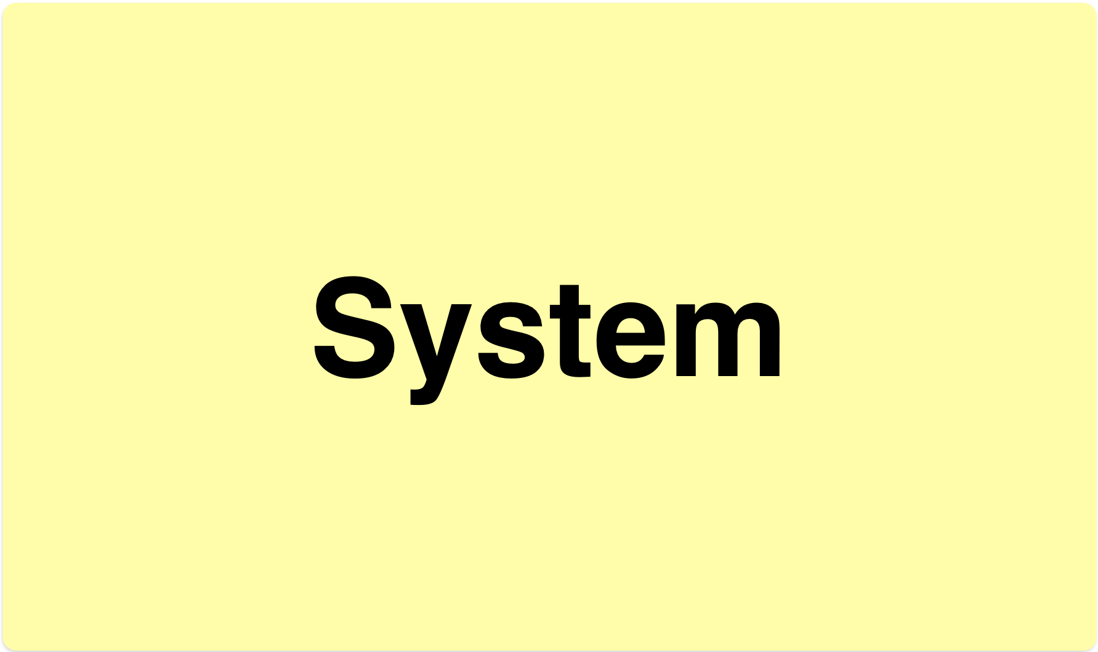
System as a single, atomic entity
Notes:
não muito útil, não diz muito, pouca informação. então precisamos passar por um processo de…

Slide 9
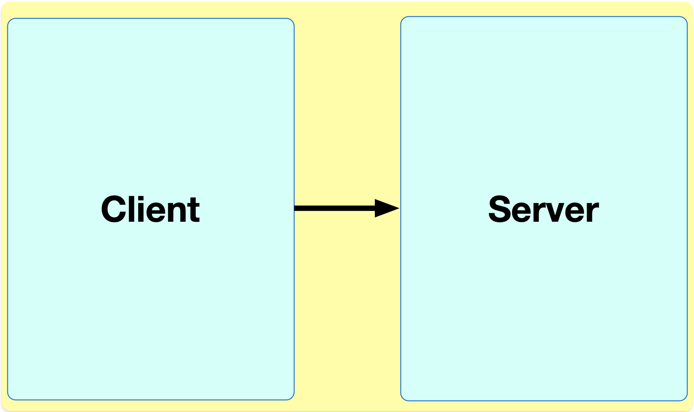
Decomposition and refinement (adding detail)
Notes:
refinamos a ideia original quebrando, decompondo, em duas partes.
e registramos tanto as partes como a direção da comunicação entre elas…

Slide 10

Modules and their communication
module,
subsystem,
component
communication driven by Client
Client depends on Server
data might flow in both directions
Notes:
essas decisões de que partes criar, e como elas vão se comunicar, é direcionado…

Slide 11
Directed by the existing requirements
aimed at satisfying such requirements
Notes:
mas é importante ressaltar que …

Slide 12
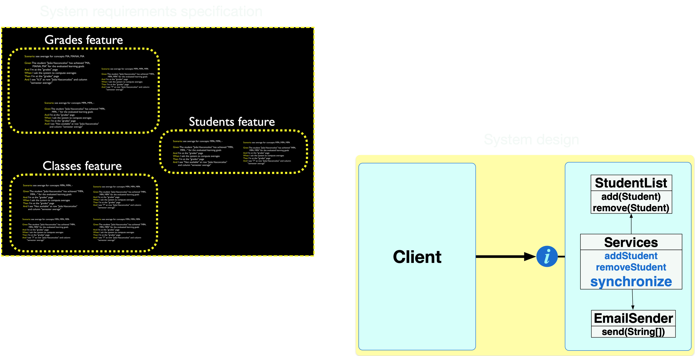
Feature structure and module structure often do not match
crosscutting feature
Notes:
no one-to-one mapping between feature and module.
o que vimos até agora…

Slide 13
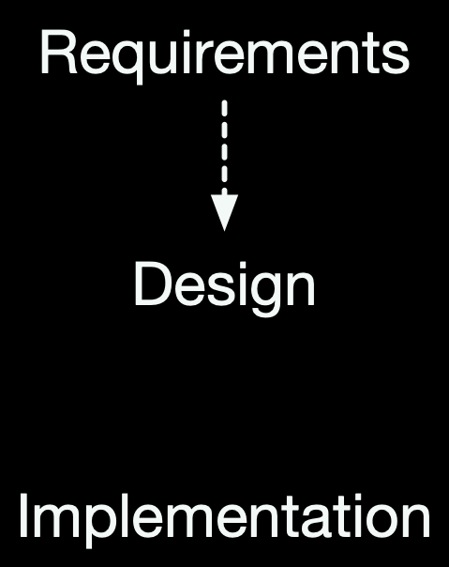
Top-down, decomposition
requirements
information guides the process
Notes:
pode ser também no sentido contrário…

Slide 14
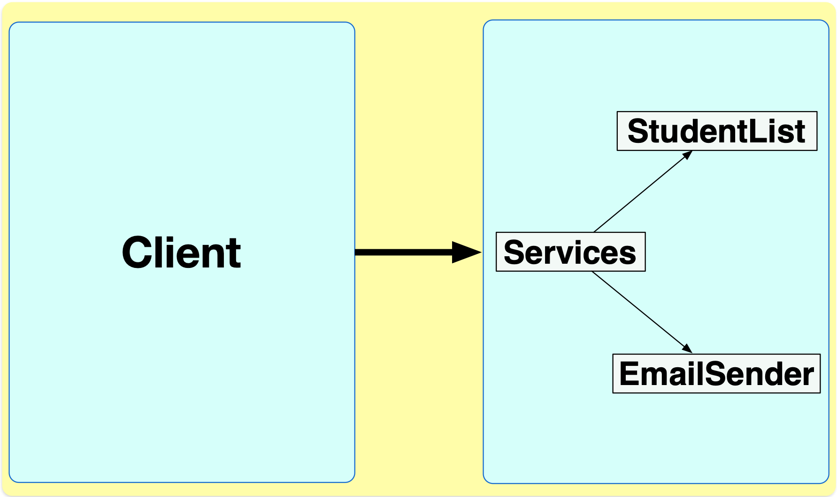
Composition and refinement
existing, implemented module
nonexisting, invented module
existing, implemented module
Notes:
quando baseado na composição de soluções existentes, já implementadas, a serem reusadas, como StudentList e EmailSender.
ou misto, como nesse caso, já que Services foi concebido e precisa ainda ser implementado.
de fato, quando há composição…

Slide 15
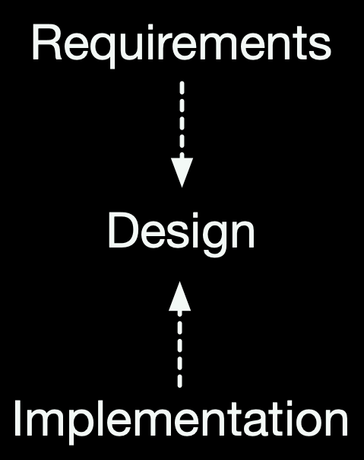
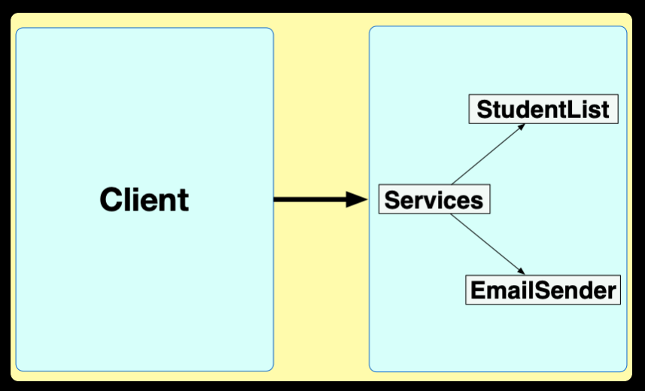
Bottom-up, composition
requirements and implementation
information guides the process
Notes:
além de decomposição, composição, e refinamento, precisamos também de…

Slide 16
Decomposition
Composition
Refinement
Abstraction
Design through…
Notes:
para especificar interfaces entre os módulos…
pares de operacoes que vao em sentidos diferentes (dec x comp: aumentar ou reduzir partes, granulosidade) (ref x abst: revelar ou esconder detalhe, reduzir or aumentar opções de implementação)

Slide 17
Software and systems engineering
Paulo Borba
Informatics Center
Federal University of Pernambuco
pauloborba.cin.ufpe.br

Slide 18
How to use abstraction during system design?

Slide 19
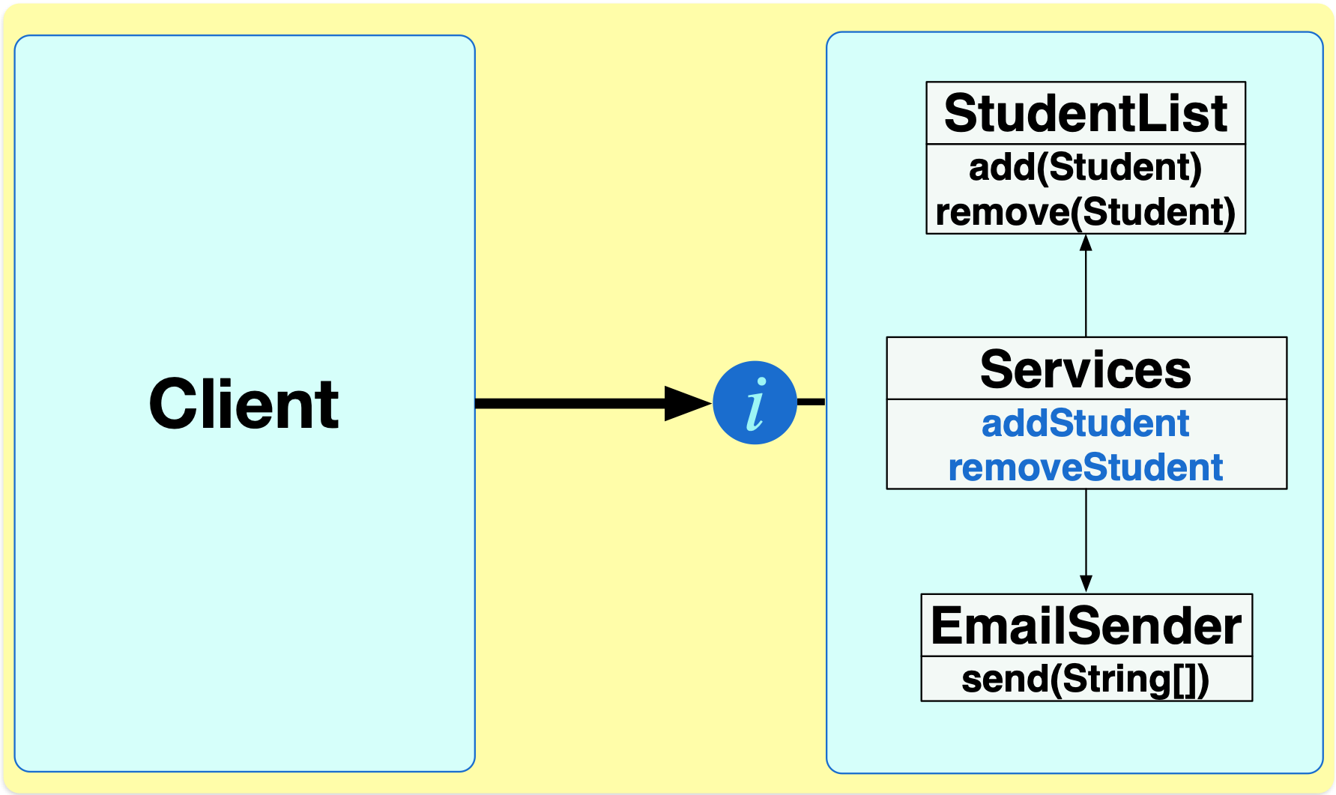
Abstract details that are not necessary for module communication
Notes:
para comunicação, client só precisa, só tem direito a acessar o azul. o resto pode ser modificado sem prejuízo/impacto.
clientela e herança, deixar claro os conceitos. e diferenciar de cliente de cliente servidor, que é apenas um caso especial de cliente
dar exemplo do BB, onde o mesmo servidor vai interagir com mais de um tipo de cliente diferente (o desktop do funcionario, o aplicativo web, o caixa eletronico, o app do celular)

Slide 20
Think of a module as an abstract data type (data + operations) or an abstract machine
hidden by the module, information hiding, encapsulation
visible, part of the module
interface
data can only be accessed through the visible operations
interface specification, establishes what is provided (and required) by the module to its clients
Notes:
ideia de interface como plug de tomada, interface usb, encaixe…
a definicao que eu prefiro é encapsulamento como sendo a capacidade de agrupar/encapsular declarações em um módulo. você pode ver como colocando items em uma garrafa/capsula transparente. e information a capacidade de esconder parte das declarações, tornar parte da garrafa não transparente. em java, a declaracao da classe encapsula, mas o private é que esconde.

Slide 21
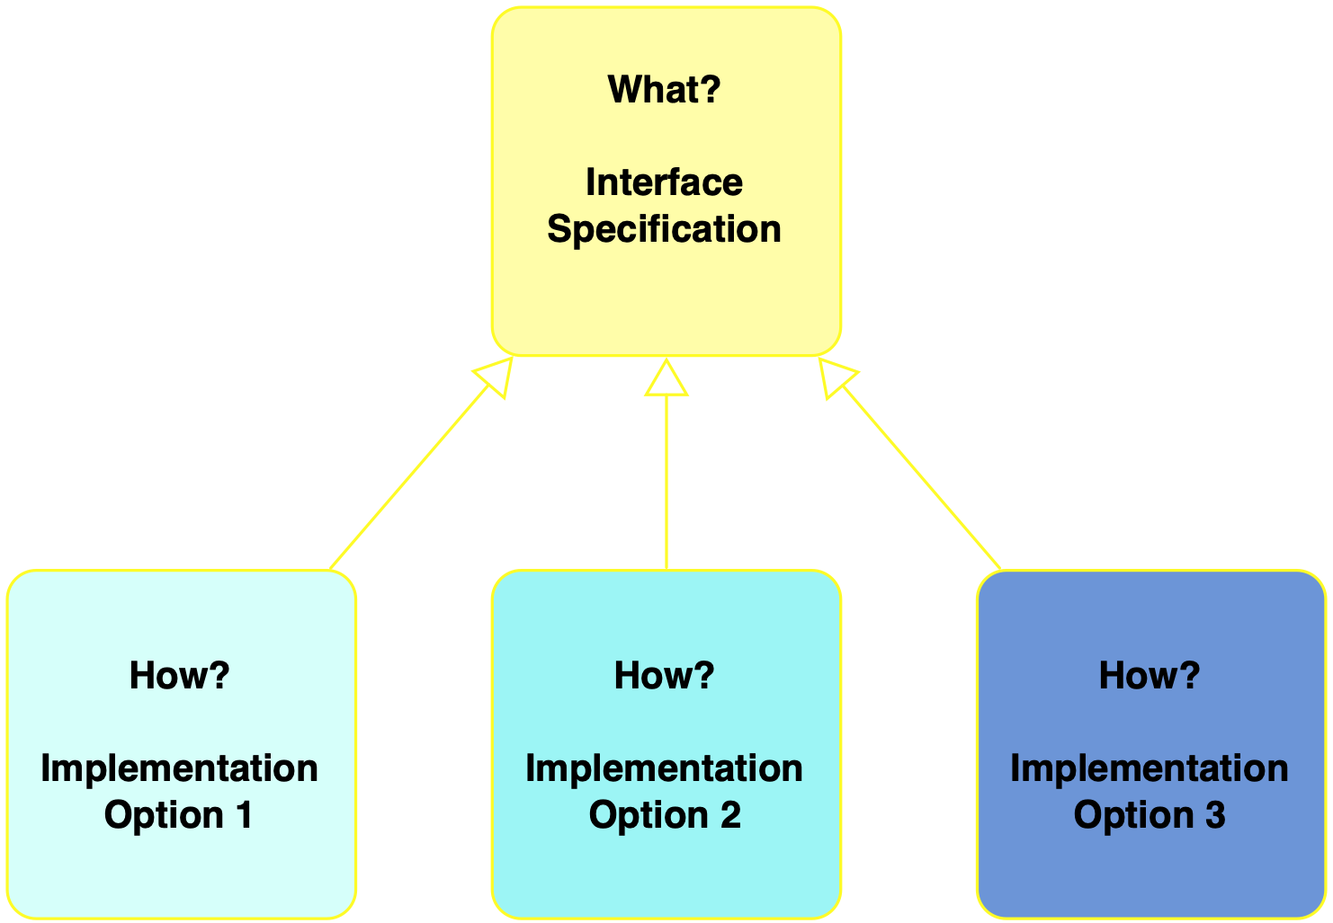
Interface reduces dependencies, and enable implementation options
abstracts
refines
implementation is correct if it satisfies specification

Slide 22
Abstraction and refinement in a single step
abstracting by specifying an interface
and hiding method and class information
refining by adding method information
Notes:
para comunicação, client só precisa, só tem direito a acessar o azul. o resto pode ser modificado sem prejuízo/impacto.

Slide 23
Inventing abstractions to implement modules and systems (collections of modules)
online shopping modules:
browsing (preference data - catalogue data),
ordering (shopping cart and orders data -
inventory data),
payment (credit card data - customer data),
delivery (tracking data)

Slide 24
A similar process applies for interacting systems
Uniform approach for internal modules and external systems

Slide 25
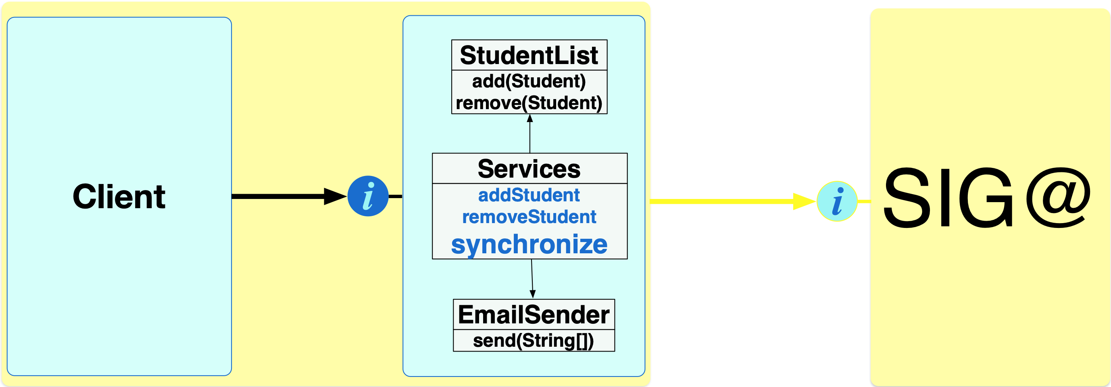
Teaching assistant

Slide 26
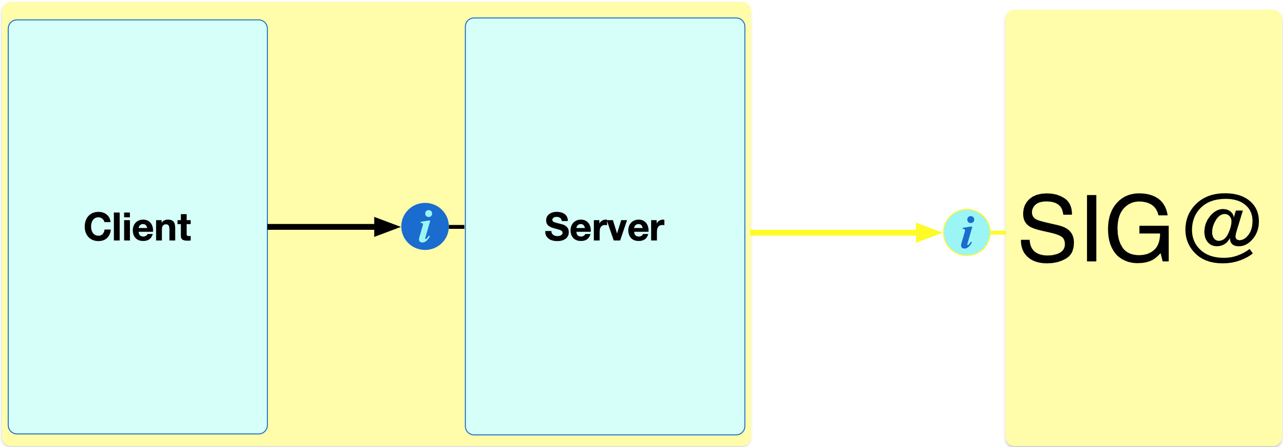
Design at different levels
Architecture design
High level design
Low level design
Code
Notes:
through 4 operations

Slide 27
The design process is a decision making process, reducing implementation options, with the aim of satisfying the system requirements
Notes:
search in a multidimensional space, where each dimension is a design parameter that can be instantiated with different values (options)
4 operations help that

Slide 28
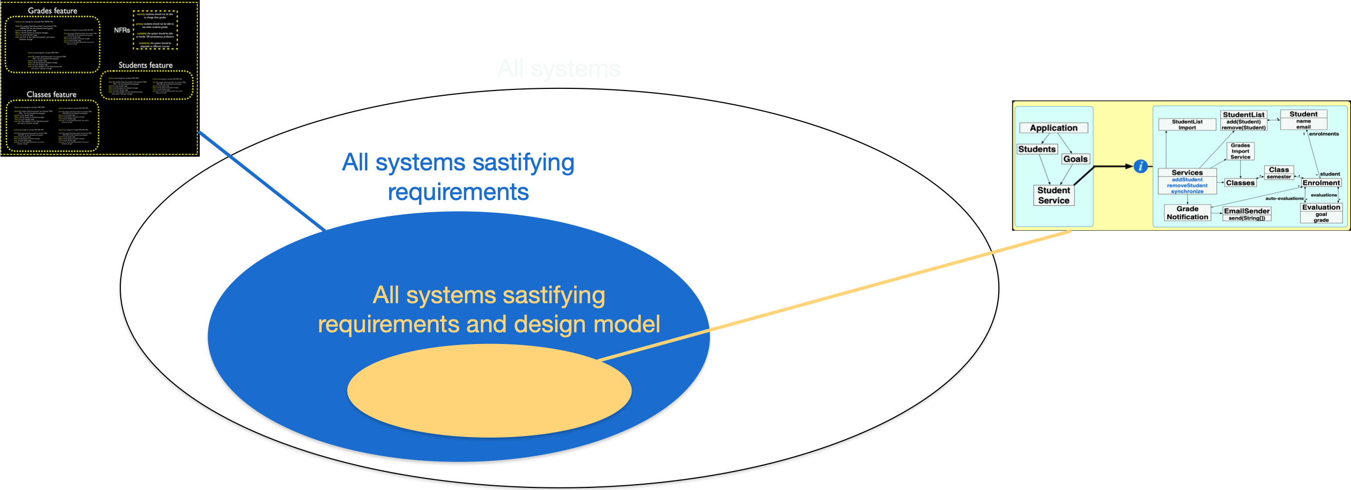
restricts system external behavior
restricts system internal structure (and behavior)

Slide 29
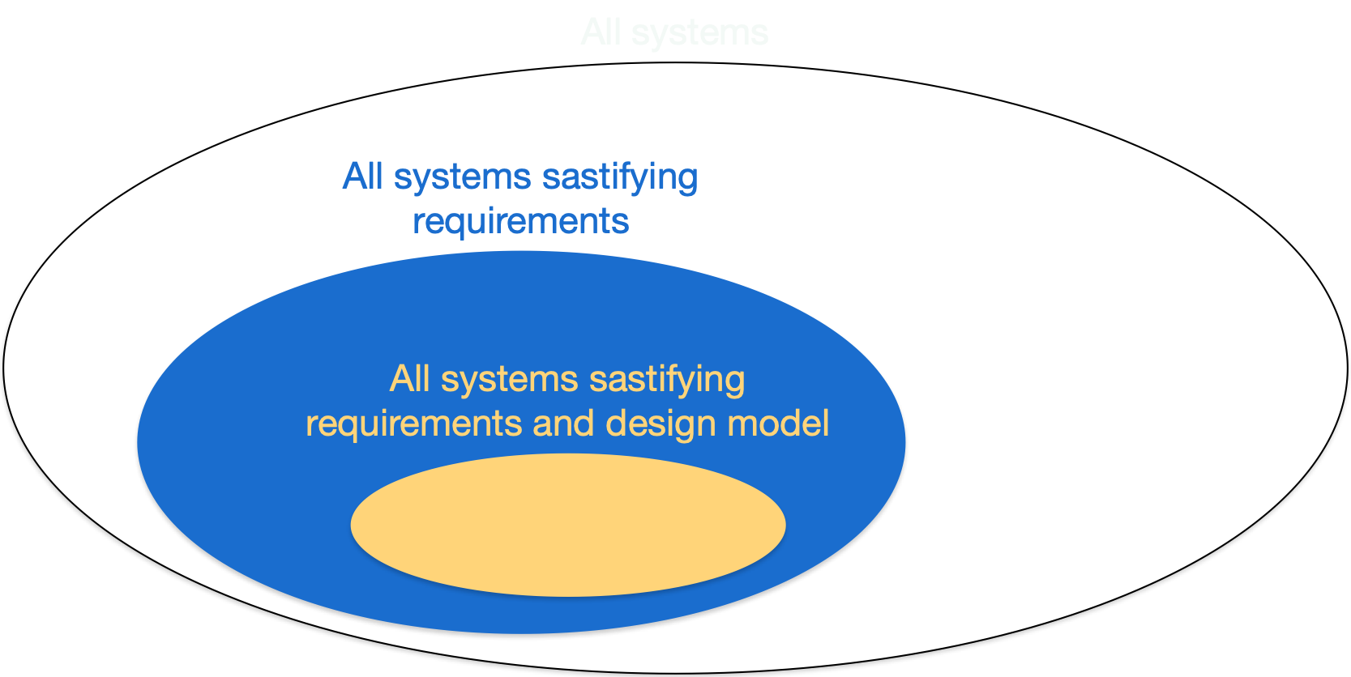
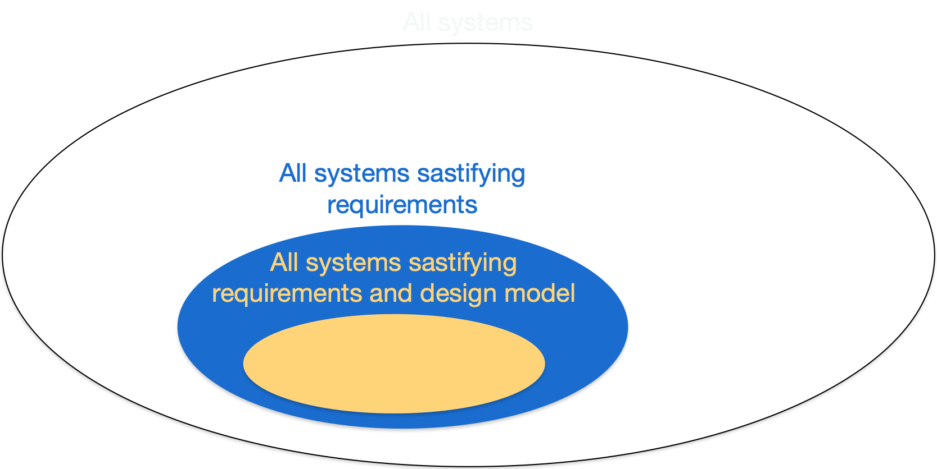
Adding
constraints
reduces
possible systems,
subset

Slide 30
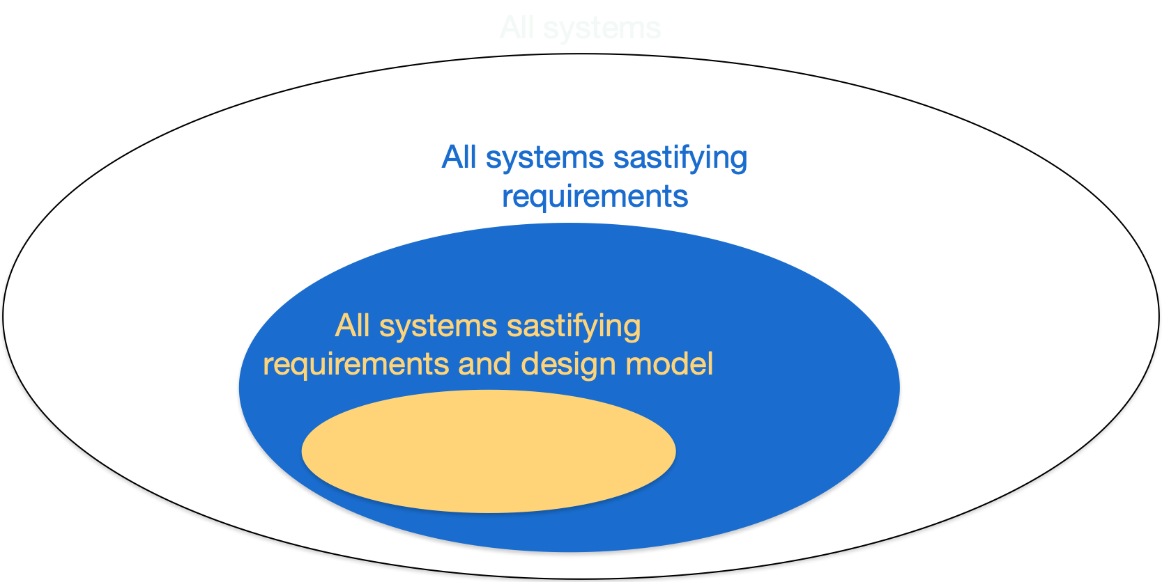
changes possible systems,
different set, not a subset
Changing
constraints

Slide 31
Software and systems engineering
Paulo Borba
Informatics Center
Federal University of Pernambuco
pauloborba.cin.ufpe.br
Notes:
assumindo que já levantamos, documentamos e validamos alguns requisitos, precisamos agora implementar o sistema. mas antes de implementar, é importante entender…

Slide 32
How to detail the design with domain driven design (DDD)?

Slide 33
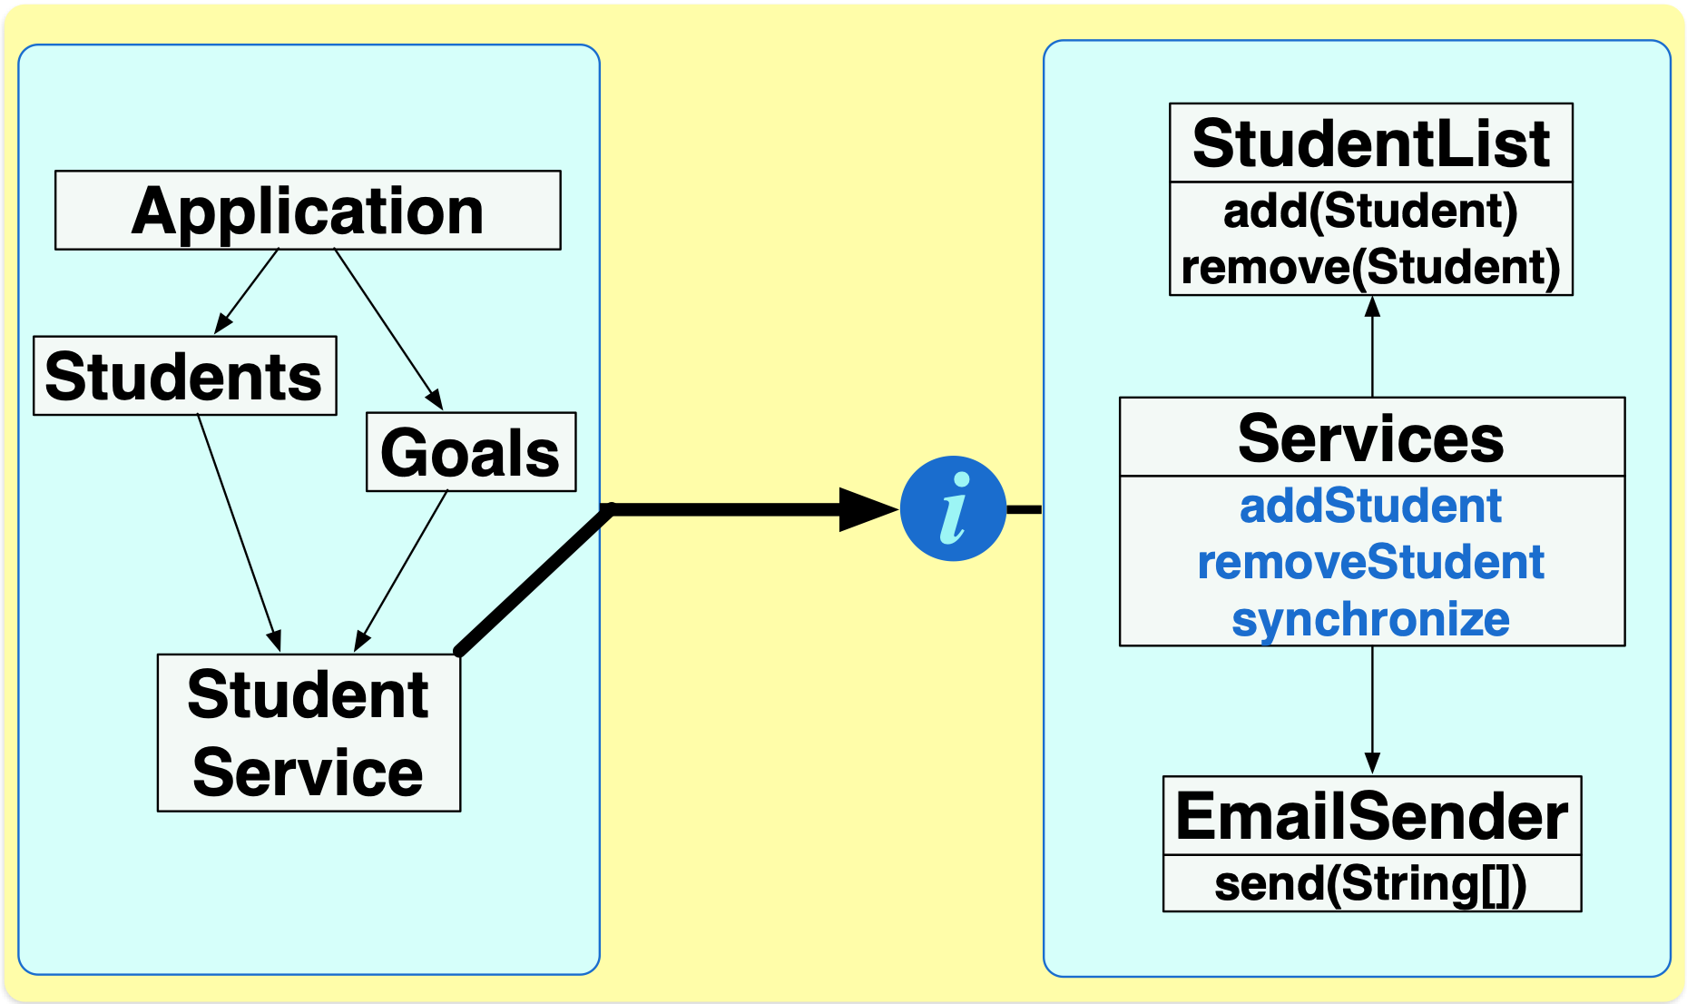
Detailing the design of the client
Notes:
cliente: com base nas funcionalidade principais… decidimos por ter menu, duas telas, serviço comum
servidor: com base nas funcionalidade principais… cadastro de alunos e envio de notificações
mas

Slide 34
Design rationale
One main module for the main menu
One module per menu option (tab view)
Could be further decomposed, for improving extensibility (readability) or enabling reuse
One module with common services
Could have others, to separate concerns and improve internal quality as well
Notes:
could not have been decomposed in the first place!
decided to decompose to improve extensibility, refine language

Slide 35
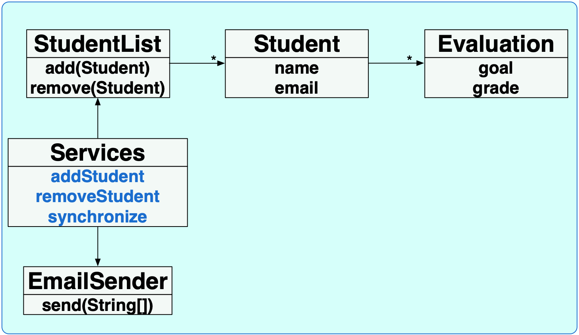
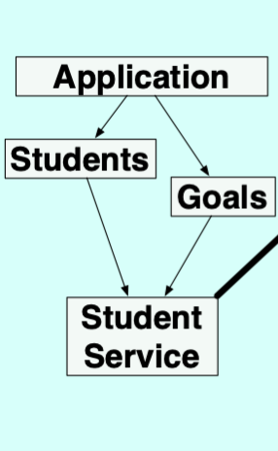

Detailing the design of the server by identifying related entities and value objects
* (0 or more)
+ (1 or more)
entity,
identity is important
value object, no identity (and maybe no mutability)

Slide 36
Design rationale
One module for Student because it’s an important concept
Could be avoided if directly accessing a database, and returning to the client only partial or unstructured information
One module for Evaluation for separation of concerns
Could be avoided by being indirectly represented inside Student, possibly compromising readability
compromises performance?
battery usage?
Notes:
could not have been decomposed in the first place!
decided to decompose to improve extensibility, refine language

Slide 37
Driven by the specified requirements
If the system is to be used every semester, the current design does not keep grade information for a student who failed in a previous semester

Slide 38
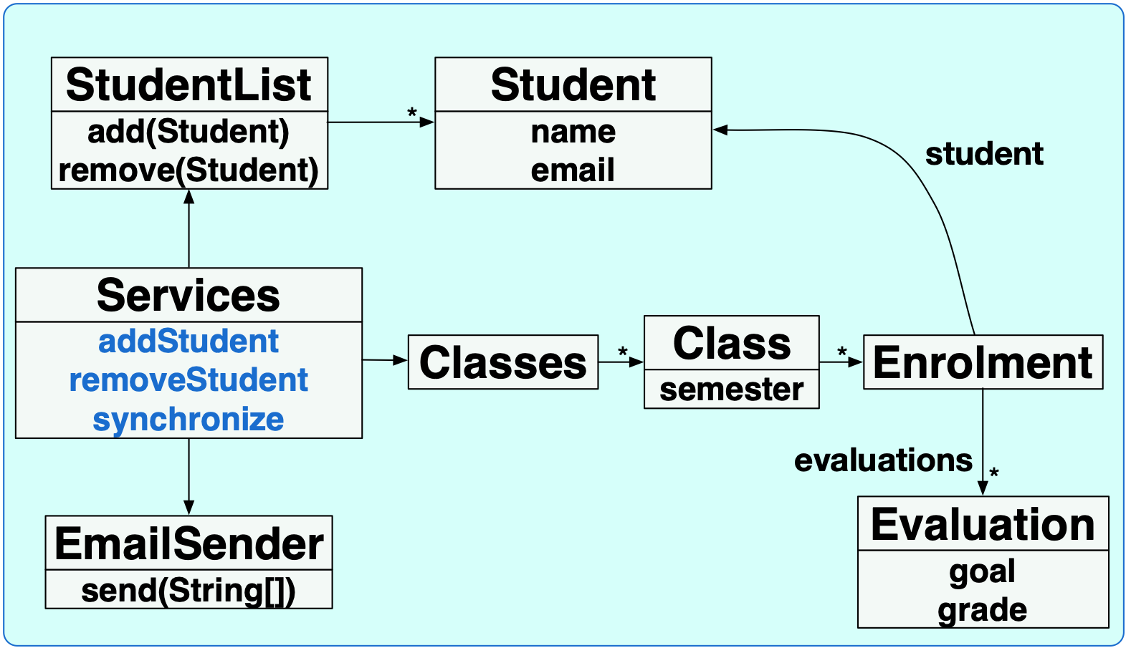
First design
Second
design

Slide 39
The best design?
Does it satisfy the requirements?
How strongly does it satisfy the requirements?

Slide 40
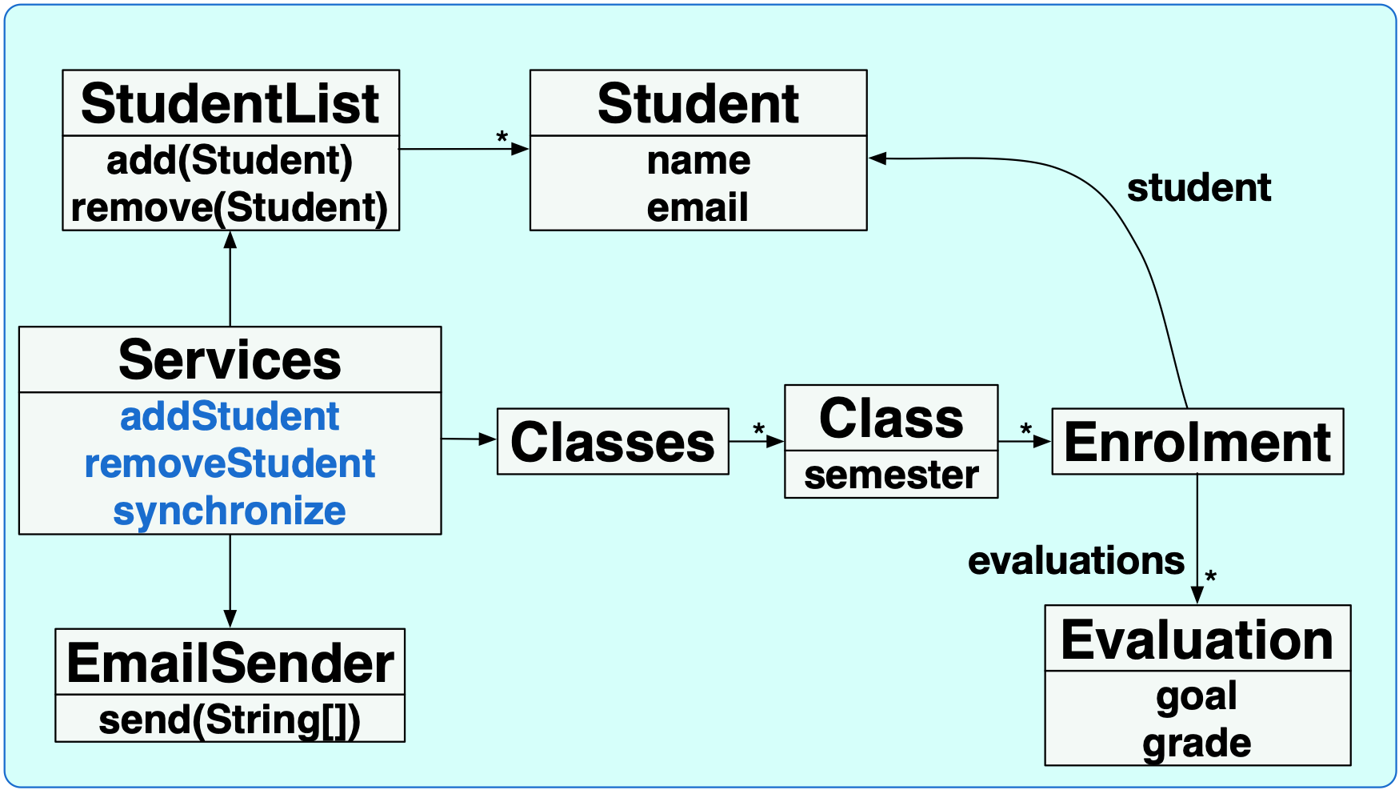
Identifying repositories
repository
entity
value object
repository, collections of objects that need direct global access
Notes:
Class would be a repository if there is a special GUI or service for directly dealing with enrolments in a direct way, not through a Class (for example if it needs to check all enrolments, not necessarily enrolments associated with a class)
Enrolment could be an entity, if there is a special Id

Slide 41
All driven by the (specified) system requirements
Are the stakeholders interested in an auto-evaluation feature?

Slide 42
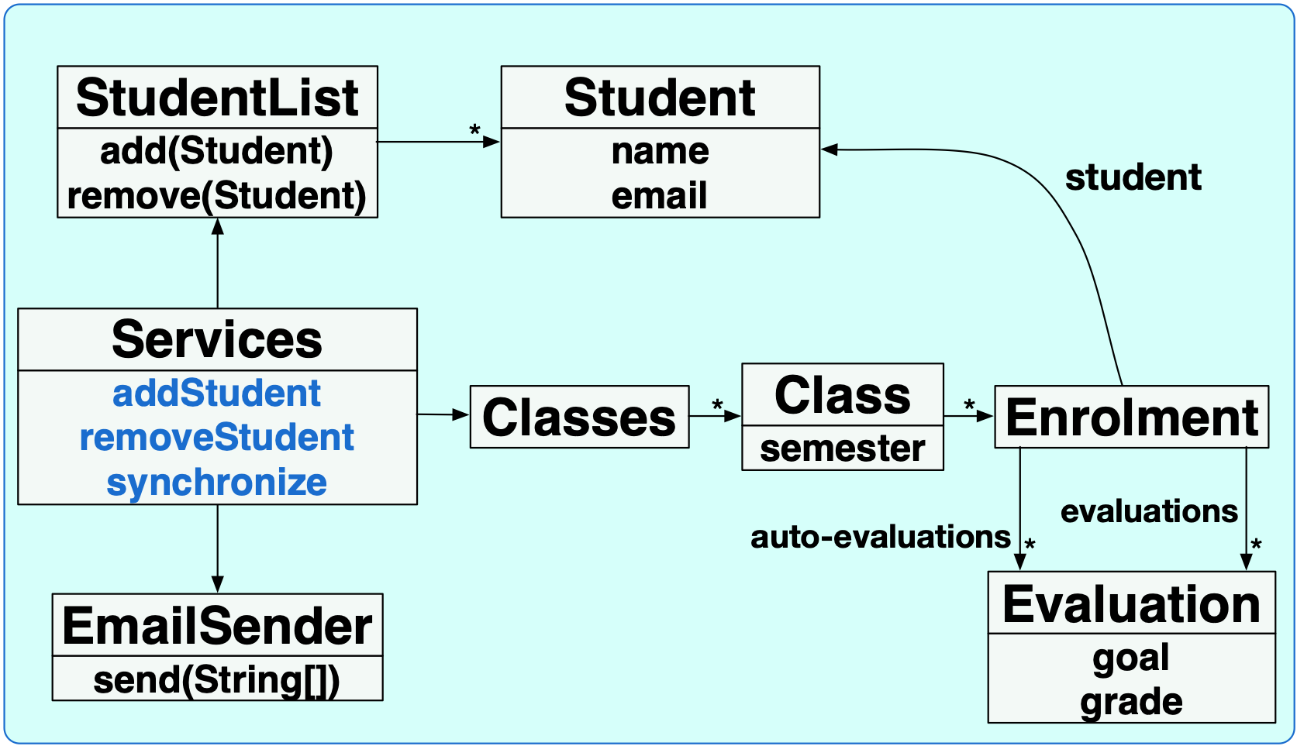
No
Yes

Slide 43
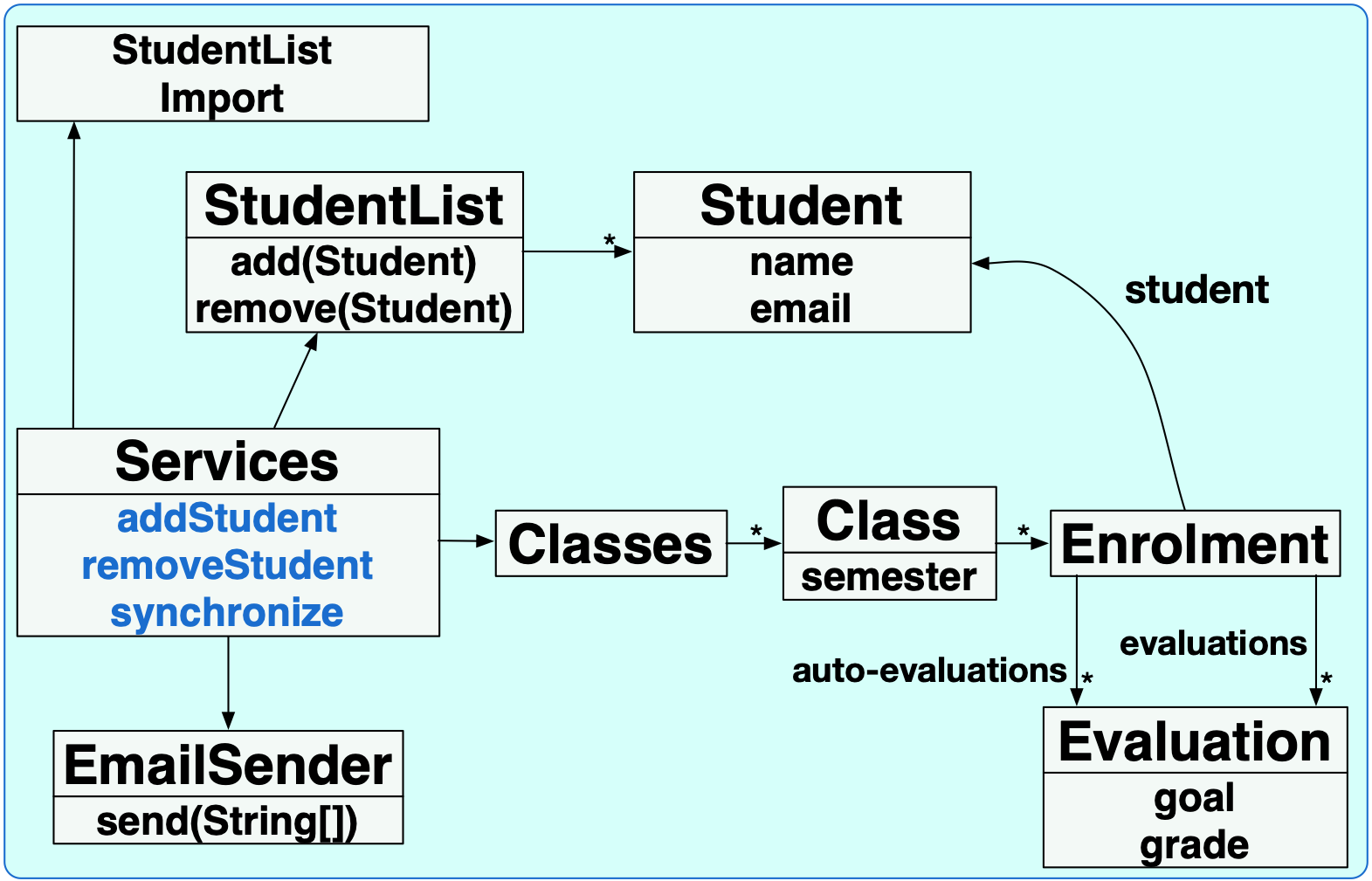
Identifying factories and services
factory, object creation logic
imports a list of students from a spreadsheet
service, stateless operation

Slide 44
All driven by the (specified) system requirements
Should notification be sent only once a day?

Slide 45
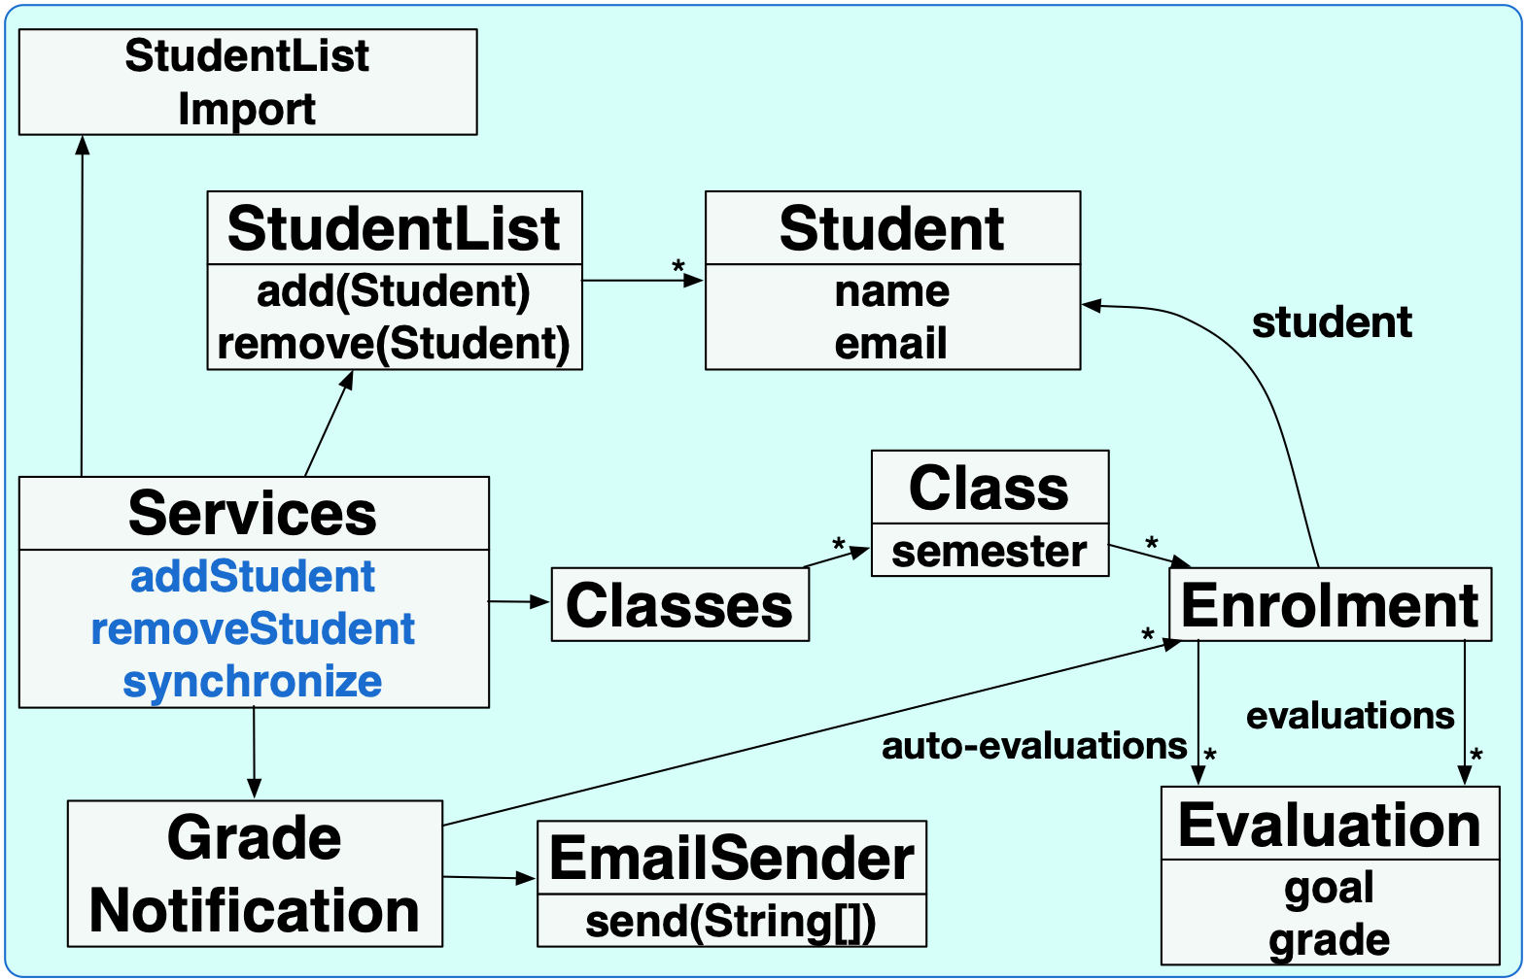
No
Yes
Notes:
solucao YES é enviar email uma vez por dia, se alguma nota foi atualizada durante o dia…; a cada atualização-chamada do serviço de atualiza- o GradeNotification (repository!) registra o enrolment modificado e no final do dia le isso e chama o send do sender
opcao de notificacao ser habilitada pela gui, fui solicitar envio de imediato, etc. mudaria um pouco pois teria que adicionar a interface com o client

Slide 46

Composition, aggregation, and association information
composition: contains/owns and part-of relation
aggregation: contains/owns
relation
association: accesses
relation
association: no contains/owns
Notes:
sem diamond = other kinds of associations that do not involve contains/owns relationship
composition filled diamond - destroying the owner destroys the owned
agregation open diamond - destroying the owner does not destroy the owned,
owner é a classe que contém/de onde parte a seta que se origina no diamante

Slide 47
All driven by the (specified) system requirements
If there is a need to show all enrolments from a given student

Slide 48
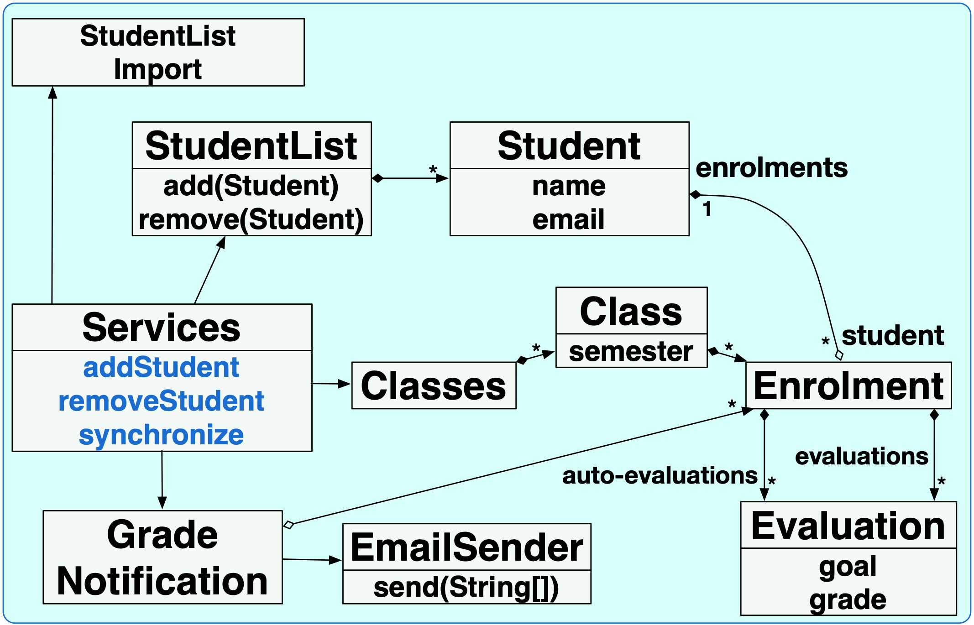
bidirectional relation
student is composed of 0 or more…
enrolment aggregates one…

Slide 49
All driven by the (specified) system requirements
If there is a need to import student grades from a spreadsheet

Slide 50
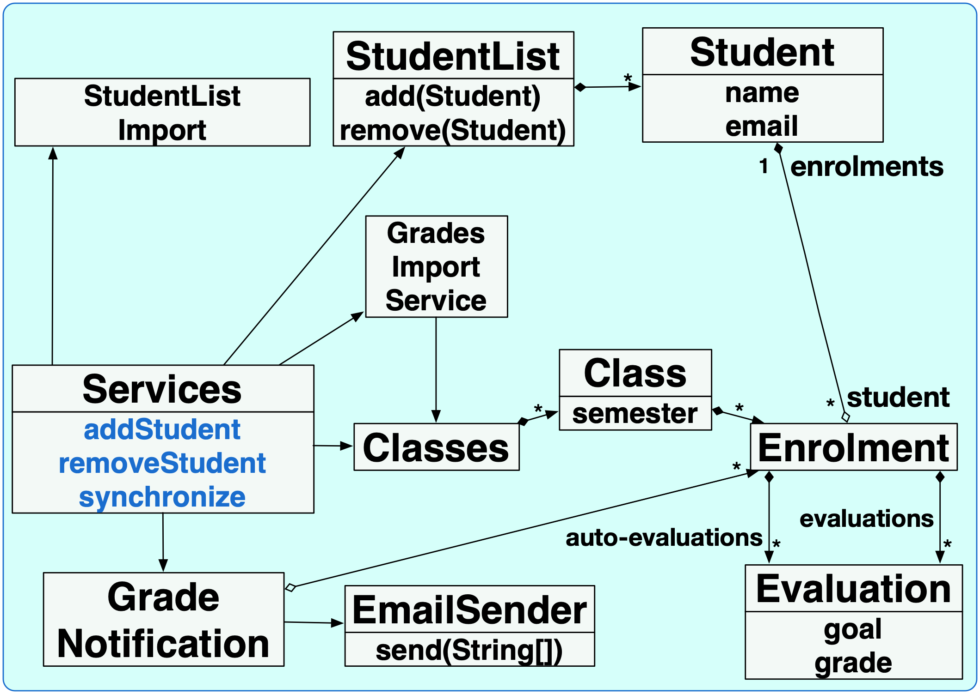
parses grades spreadsheet and update evaluations
Notes:
link to classes could be avoided if evaluation update logic/loop was kept inside service.

Slide 51
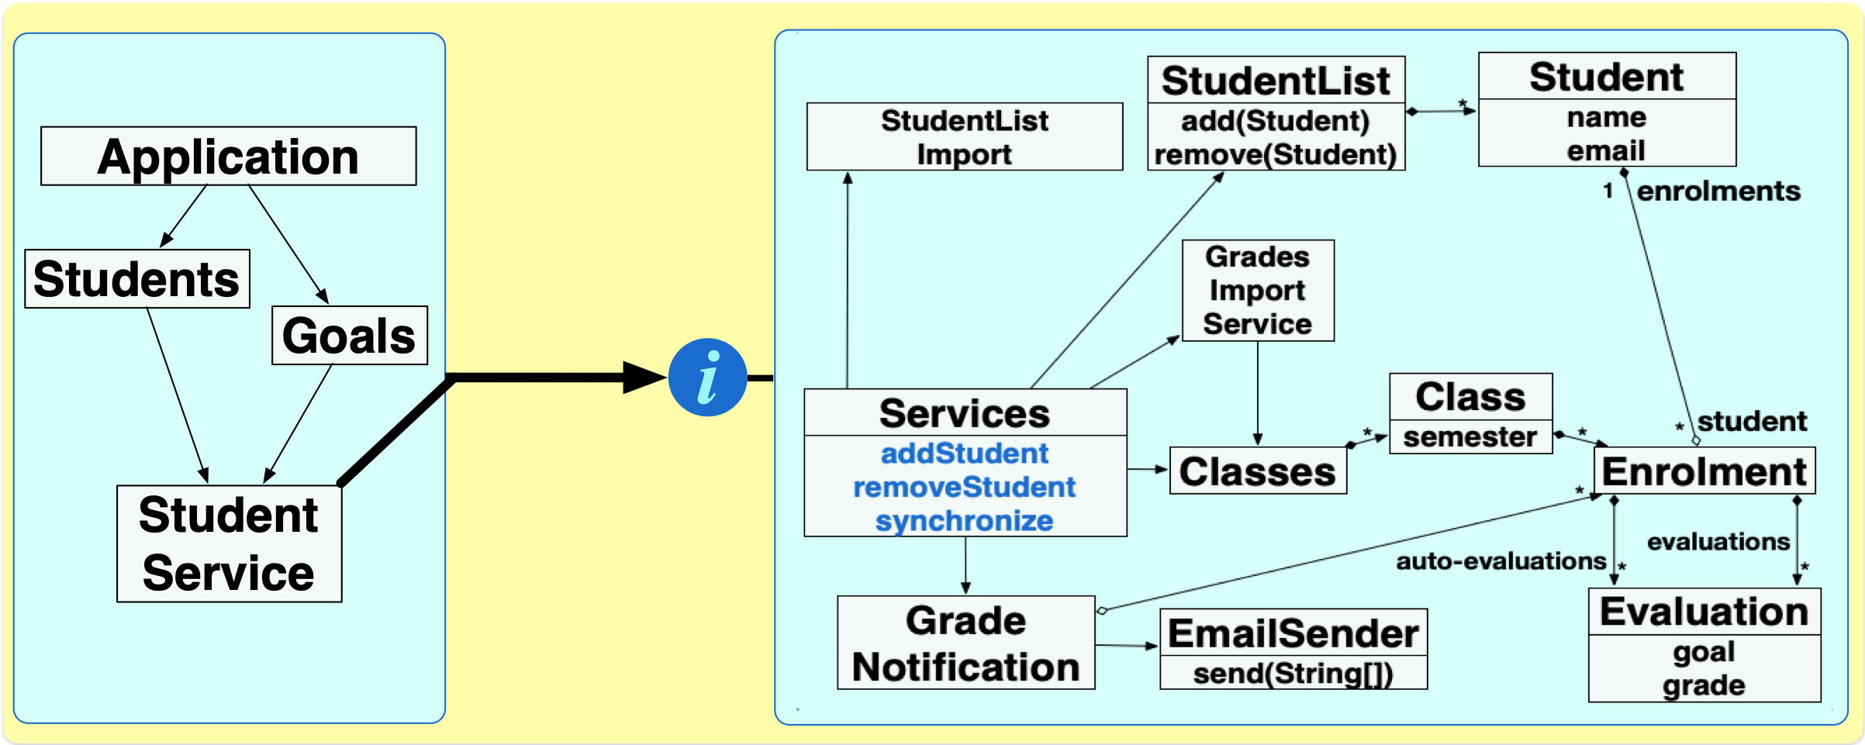
Check if scenarios can be implemented by that
Notes:
mentally run scenario execution on top of this structure

Slide 52
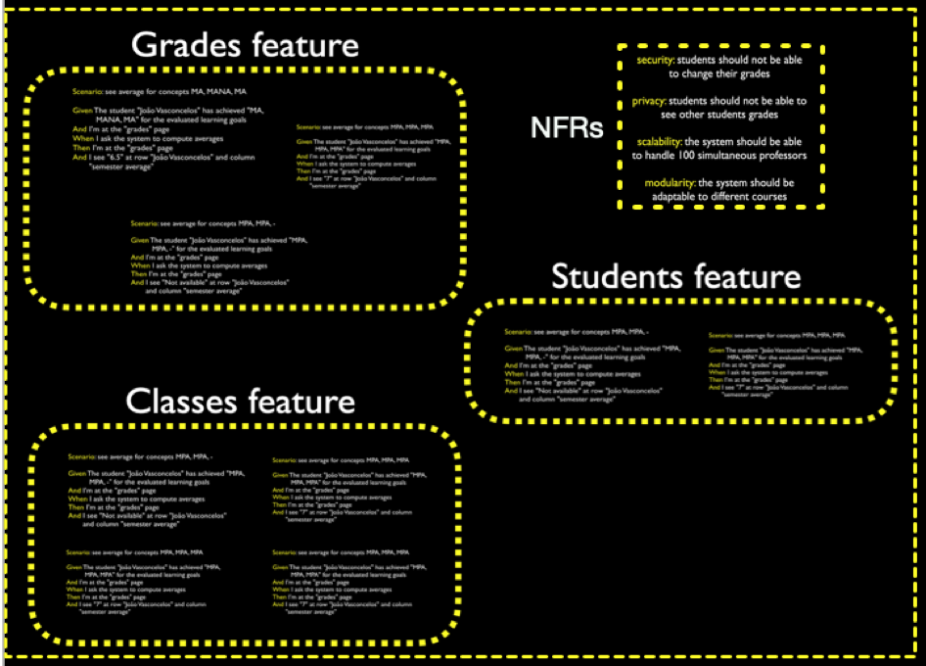
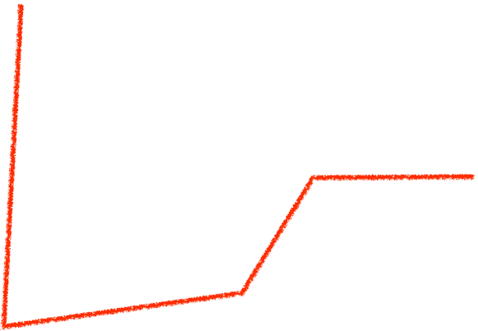
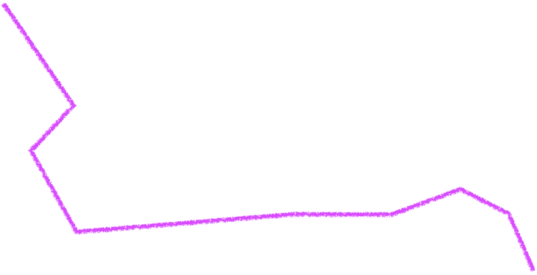
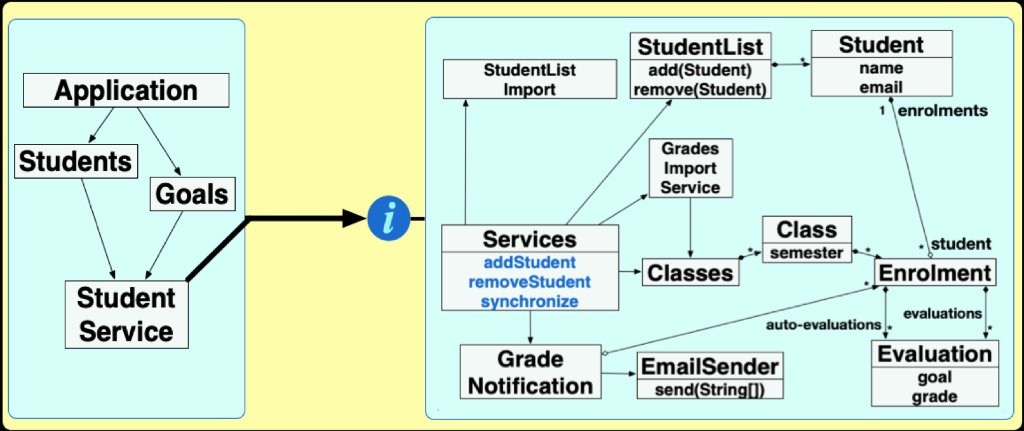
Mentally running
scenario actions
against
model structure

Slide 53
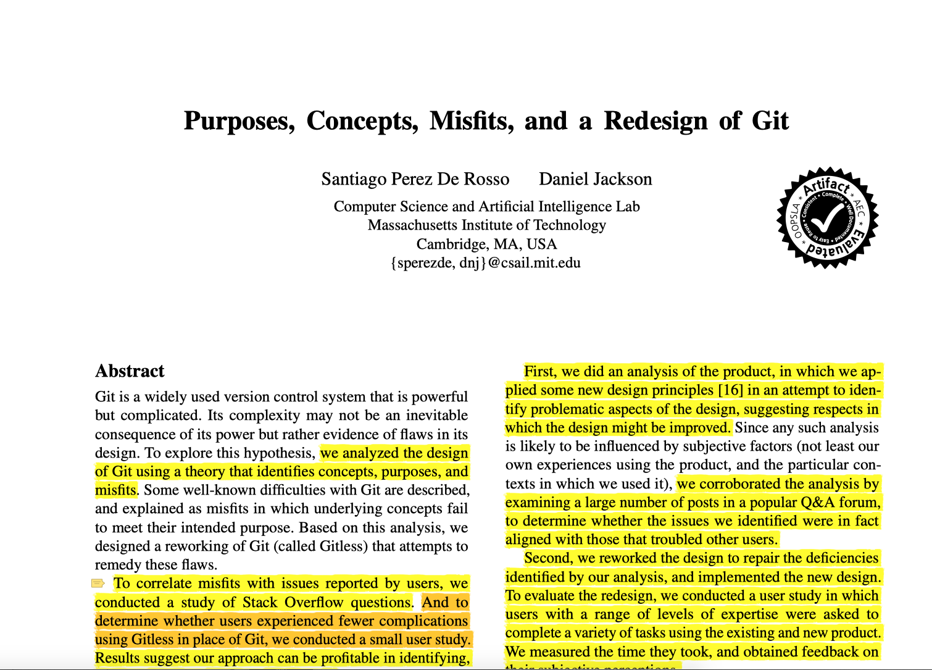
To avoid misfits, aim at
one-to-one mapping between purposes and concepts

Slide 54
DDD models
abstraction
about information, stored and manipulated by the system, and its containment and association relations
objects that create, store, and accesses such information
not about GUI, pages, and navigation
not about authorisation, responsibility, invocation, influence, executes, requests service, etc.

Slide 55
The system design captures a common language used by the team
The system design is distilled knowledge on how the team structures domain knowledge and understand main concepts
The system design summarises the implementation

Slide 56
System modelling studio

Slide 57
Hands on exercises
Notes:
Indo de aluno por aluno, verificando o progresso, e registrando como comentário no assignment do classroom.
You can find assertions on the web that say
POST should be used to create a resource, and PUT should be used to modify one
PUT should be used to create a resource, and POST should be used to modify one
Neither is quite right.
Better is to choose between PUT and POST based on idempotence of the action.
PUT implies putting a resource - completely replacing whatever is available at the given URL with a different thing. By definition, a PUT is idempotent. Do it as many times as you like, and the result is the same. x=5 is idempotent. You can PUT a resource whether it previously exists, or not (eg, to Create, or to Update)!
POST updates a resource, adds a subsidiary resource, or causes a change. A POST is not idempotent, in the way that x++ is not idempotent.
By this argument, PUT is for creating when you know the URL of the thing you will create. POST can be used to create when you know the URL of the "factory" or manager for the category of things you want to create.
so:
POST /expense-report
or:
PUT /expense-report/10929

Slide 58
Design, implementation, and maintenance 1

Slide 59
Software and systems engineering
Paulo Borba
Informatics Center
Federal University of Pernambuco
pauloborba.cin.ufpe.br
Notes:
assumindo que já levantamos, documentamos e validamos alguns requisitos, precisamos agora implementar o sistema. mas antes de implementar, é importante entender…

Slide 60
Design, implementation, and maintenance 2
Notes:
QUASE NAO SOBROU TEMPO PARA O ROTEIRO. REDUZIR CONTEUDO, OU TALVEZ MANTER MAS NAO APRESENTAR EXEMPLOS NO QUADRO, E SIM NOS SLIDES

Slide 61
Software and systems engineering
Paulo Borba
Informatics Center
Federal University of Pernambuco
pauloborba.cin.ufpe.br

Slide 62
Which principles guide the design process?
Notes:
o processo de design, especialmente a aplicação das operações de decomposição, composição, refinamento e abstração, é direcionado pelos requisitos funcionais e não funcionais…
para ajudar a obter requisitos não funcionais que correspondem a fatores de qualidade interno, a experiencia e a pesquisa em ES derivou, ao longo do tempo princípios… é importante entender quais.
na verdade…

Slide 63
Design process should also be guided by…
Values
Principles
Patterns
architectural, design, implementation

Slide 64
Coding and design values
Communication: focus on the reader
Simplicity: minimize complexity
dependencies, obscurity, over engineering
Flexibility: easy to change, in expected ways
Precision: names aligned to behavior
Notes:
exemplos concretos para cada um desses, idealmente mostrando antes e depois de seguir o principio
revisar quais sao mais uteis e concordo mais, e só manter esses. poucos princípios mais efetivos, todos com exemplos, ao invés de muitos princípios pouco efetivos.

Slide 65
Software and systems engineering
Paulo Borba
Informatics Center
Federal University of Pernambuco
pauloborba.cin.ufpe.br

Slide 66
Modularity principles
Low coupling, reduced dependencies
method calls
object creation
references
inheritance, implementation, parametrisation
High cohesion, focus on a single concern
Hide information that is likely to change, or not useful for clients

Slide 67
Main motivation is to simplify and enable independent…
understanding (local reasoning)
maintenance (extensibility)
development
reuse
that’s modularity!
avoids rippling effects

Slide 68
A modular system is...
split into separate units, language elements, modules
developed by separate work assignments, design elements, modules
relative notion: depends on what more likely changes or varies!
relative notion: depends on what you intend to independently develop, maintain, and understand!
Notes:
modular (adj) split into modules
modularity (noum)

Slide 69
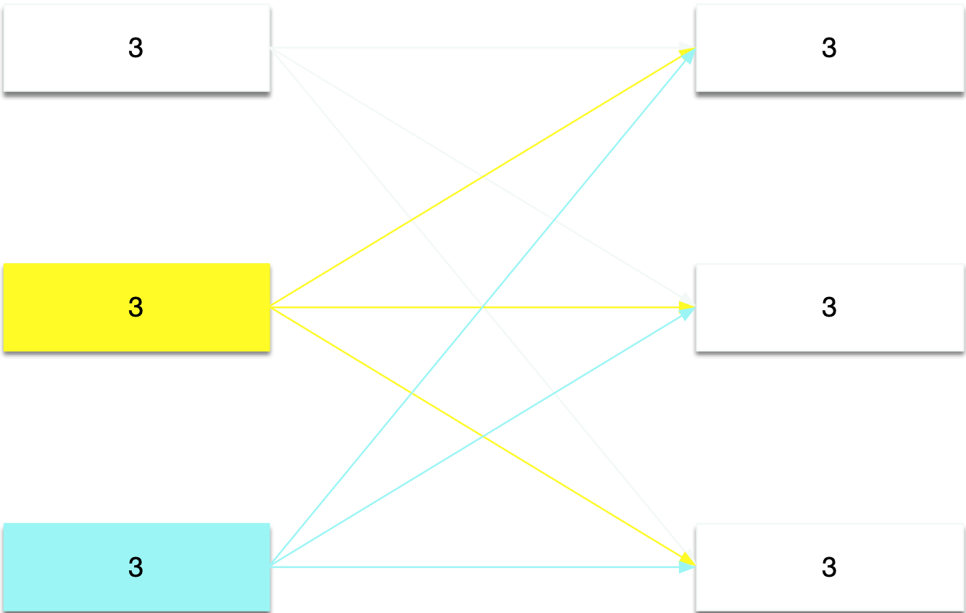
High coupling, too many dependencies
might be affected by changes in 3 other classes
changes here might affect 3 other classes
Notes:
3 in source represents source class depend on 3 other classes, and might change if they do change
3 in target represents 3 class depend on the target class, and they might change if the target class changes

Slide 70
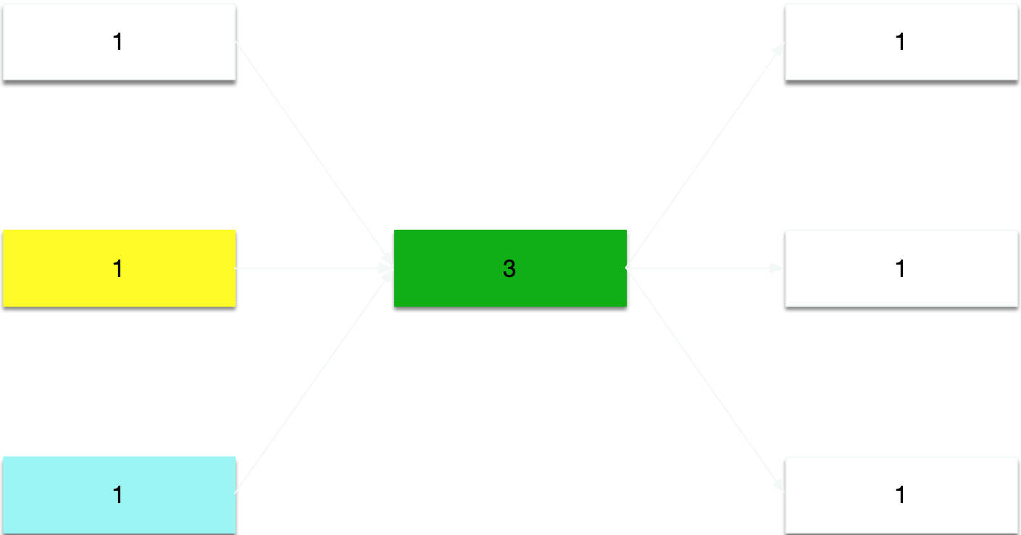
Low coupling: reducing dependencies by adding intermediate class
reduces complexity,
introduces indirection
Notes:
3 in source represents source class depend on 3 other classes, and might change if they do change
3 in target represents 3 class depend on the target class, and they might change if the target class changes

Slide 71
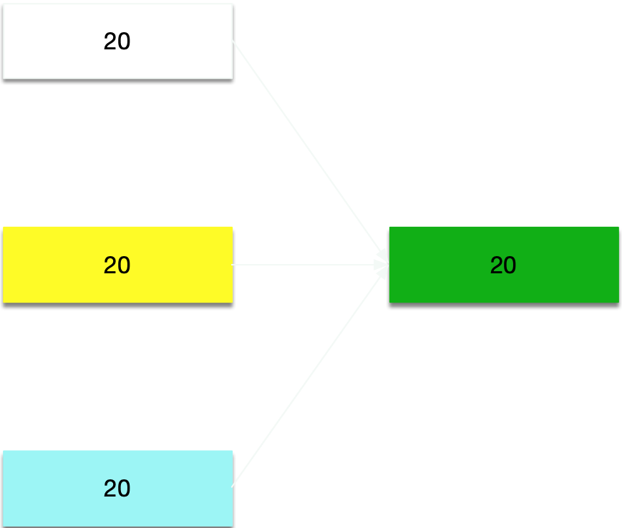
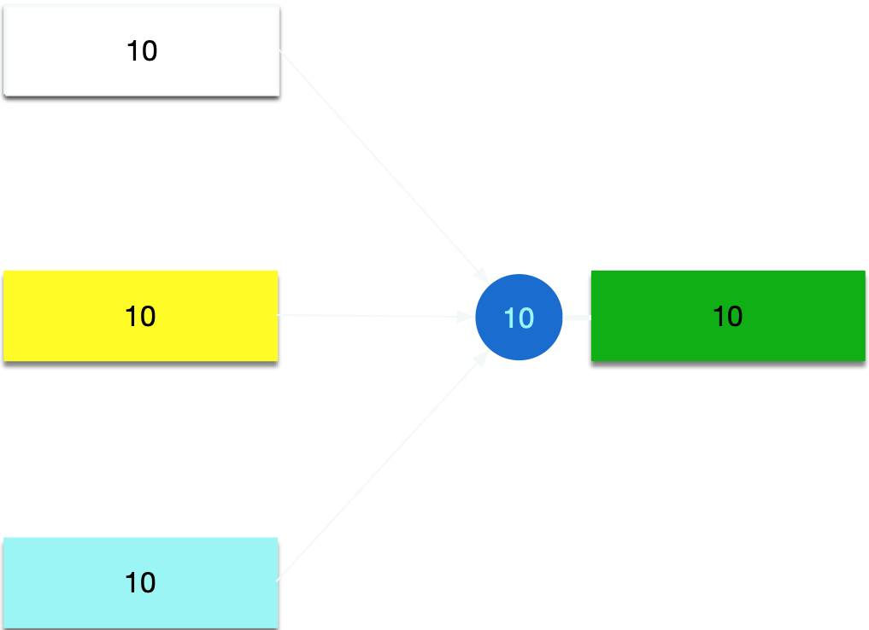
Low coupling: reducing dependencies by adding an interface
hiding information (depend upon abstractions, do not depend upon concretions)
might depend on 20 methods
Notes:
a definicao que eu prefiro é encapsulamento como sendo a capacidade de agrupar/encapsular declarações em um módulo. você pode ver como colocando items em uma garrafa/capsula transparente. e information a capacidade de esconder parte das declarações, tornar parte da garrafa não transparente. em java, a declaracao da classe encapsula, mas o private é que esconde.

Slide 72
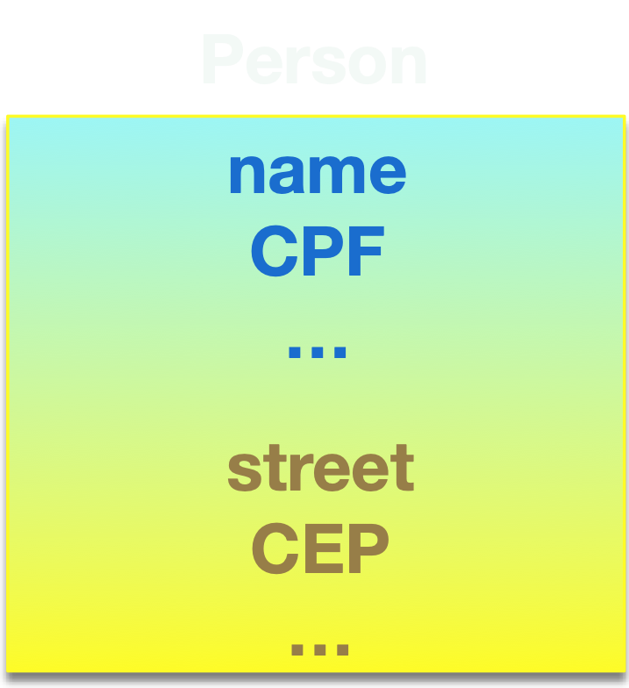
Low cohesion, mixing code with different concerns
yellow code mostly unrelated to the blue code
no method accesses both the blue and yellow fields

Slide 73
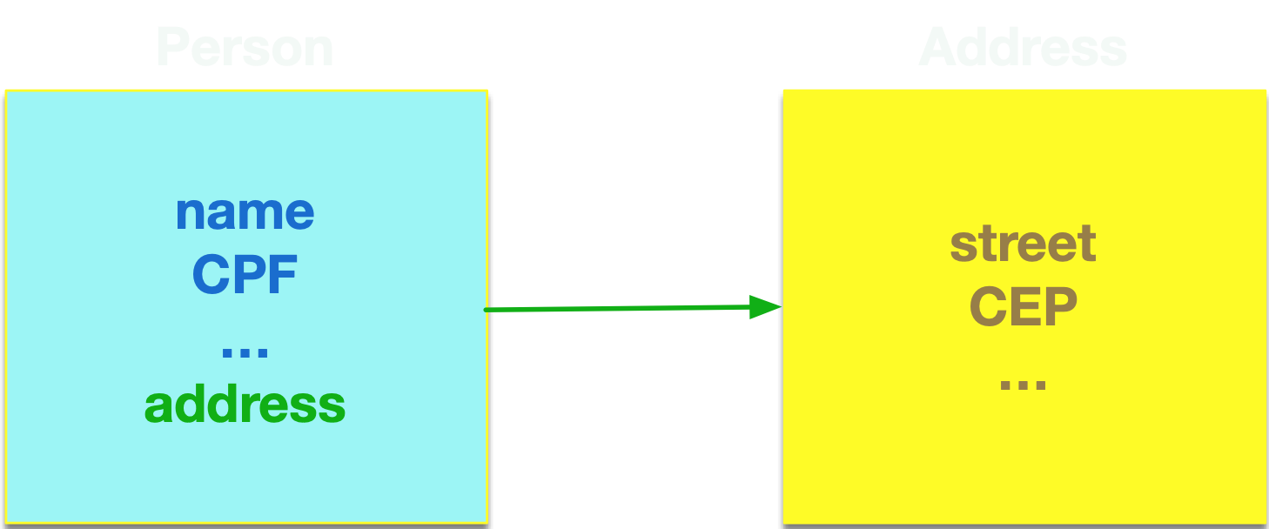
High cohesion: increasing focus by splitting a module

Slide 74
Low cohesion and agility, more defects, high costs
different colors represent code associated with different features, or concerns
{GameMenu.MENU_OPTION_ID_PLAY,GameMenu.MENU_OPTION_ID_C
ONFIG_SOUND,GameMenu.MENU_OPTION_ID_ARENA_SHOW_RANKING,GameMenu.MENU_OPTION_ID_HELP};
//#else
//#public final int[] mainMenuCommands = {GameMenu.MENU_OPTION_ID_PLAY,GameMenu.MENU_OPTION_ID_CONFIG_SOUND,GameMenu.MENU_OPTION_ID_HELP};
//#endif
/** Main pause menu options. Shown in the menu when game is paused */
private final int[] mainPauseMenuCommands = {
GameMenu.MENU_OPTION_ID_RESUME,GameMenu.MENU_OPTION_ID_TRACK_11,GameMenu.MENU_OPTION_ID_TRACK_12
}private final int[] helpCommands = {
GameMenu.MENU_OPTION_ID_HELP_GOAL,
GameMenu.MENU_OPTION_ID_HELP_STRAIGHTS,
GameMenu.MENU_OPTION_ID_HELP_CURVES,
GameMenu.MENU_OPTION_ID_HELP_ABOUT
};
/** Pause exit menu options */
private final int[] pauseMenuRestartCommands = {
GameMenu.MENU_OPTION_ID_PAUSE_RESTART_YES,
GameMenu.MENU_OPTION_ID_PAUSE_RESTART_NO
}; private final int[] endRaceMenuCommands = {
GameMenu.MENU_OPTION_ID_ARENA_POST_SCORE,
GameMenu.MENU_OPTION_ID_END_RACE_RETRY,
GameMenu.MENU_OPTION_ID_END_RACE_SELECT_TRACK,
GameMenu.MENU_OPTION_ID_BACK_MAIN_MENU
};\
//# private final int[] endRaceMenuCommands = {
//# GameMenu.MENU_OPTION_ID_END_RACE_RETRY,
//# GameMenu.MENU_OPTION_ID_END_RACE_SELECT_TRACK,
//# GameMenu.MENU_OPTION_ID_BACK_MAIN_MENU
//# }; */
private int PREVIOUS_KEY_CODE = MainCanvas.UP_PRESSED;
private int NEXT_KEY_CODE = MainCanvas.DOWN_PRESSED;
/** Title of the menu*/
private String menuTitle;
private Image rewardUserImageMainMenu;public static final int TRACK_SELECTION_MENU = 5;
//#if feature_arena_enabled
/**
* Post ranking menu
*/
public static final int POST_SCORE_MENU = 10;
//#endif
package com.meantime.j2me.gui;
import java.util.Vector;
import com.meantime.j2me.util.Screen;
import com.meantime.j2me.util.bvg.BVGAnimator;
//#if device_graphics_transform_midp2
//# import javax.microedition.lcdui.game.Sprite;
//#else
import com.meantime.j2me.util.game.Sprite;
private static final int PRESENTATION_BACKGROUND_COLOR = 0x000000;
//#if device_screen_128x128
/** Initial car animation position x */
private static final int CAR_LEFT_INITIAL_POS_X = -78;
/** Initial car animation position y */
private static final int CAR_LEFT_POS_Y = 31;
/** Initial tire animation position y */
//#
//#endif
/** Used to left tire animatiom position x */
private int currentTireleftPosX; private BVGAnimator presentation_second_bvg;
private BVGAnimator arena_bvg;
gff
//#
Dffdsffffffffffffffffffffffffffffff
Ghrwds {
/** Constants to paint the scroll bar */
private static final int ARENA_SCROLL_HEIGHT = 92;
private static final int ARENA_SCROLL_POS_Y = 17;
//#elif device_screen_128x117
//#
//# /** Constants to paint the scroll bar */
//# private static final int ARENA_SCROLL_HEIGHT = 81;
//# private static final int ARENA_SCROLL_POS_Y = 16;
//#if sku_id_se1
//#
//#g = originalG;
//#g.drawImage(bufferImg, 0, 0, 0);
//#
//#endif} catch(Exception e){
e.printStackTrace();
}
}
public void changeScreen (innewScreenIndex;
this.nextScreenMode = newScreenMode;
this.nextScreenParam = param; /**
* Shows the last screen shown.
* If there's not a last screen (i.e., the screen index in
* the stack is public void goBack() {
int[] screenData = this.popSc
// avoid mainCanvas to go back to a waiting server screen
if (screenData[STACK_SCREEN_MODE_INDEX] == Resources.MAIN_SCREEN_MODE_ARENA_WAITING_SERVER) {
this.goBack();
return;this.changeScreen(screenData[STACK_SCREEN_INDEX],
screenData[STACK_SCREEN_MODE_INDEX],
screenData[STACK_PARAM_INDEX]);
}
this.goBack = true;
}//#public void commandAction(Command c, Displayable d) {
//#if (c == this.leftCommand) {
//#this.keyPressed(LEFT_SOFT_KEY);
//#} else if (c == this.rightCommand) {
//#this.keyPressed(RIGHT_SOFT_KEY);
//#}
//#}
//#
//#endif
tangling: mixing different concerns in the same module
scattering: concern implementation not in a single module

Slide 75
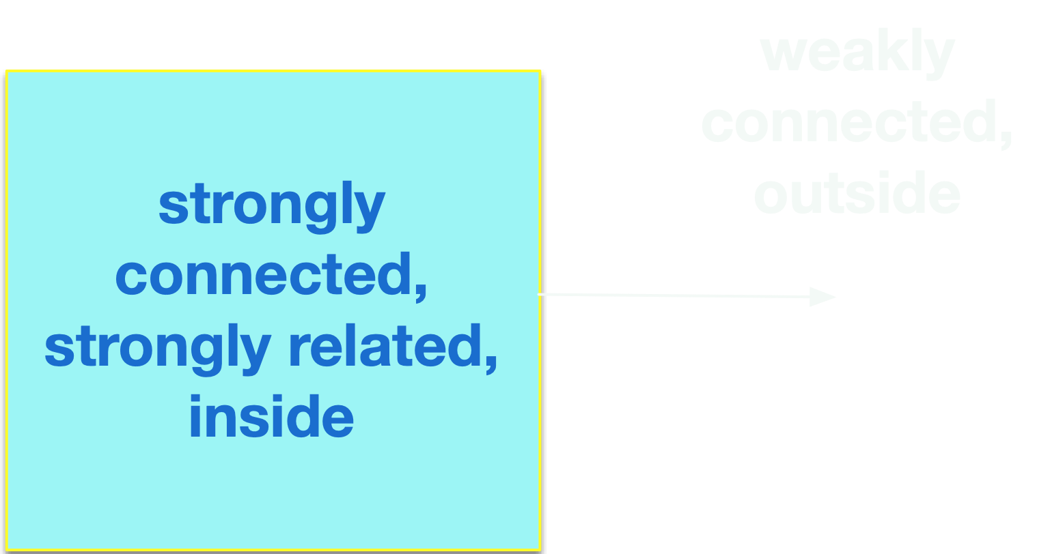
Modularity through high cohesion and low coupling

Slide 76
Software and systems engineering
Paulo Borba
Informatics Center
Federal University of Pernambuco
pauloborba.cin.ufpe.br

Slide 77
SOLID design principles
Single responsibility
Open-closed
Liskov Substitution
Interface segregation
Dependency injection
Demeter

Slide 78
Single responsibility: a class should have a single responsibility
two responsibilities
single responsibility
improving cohesion

Slide 79
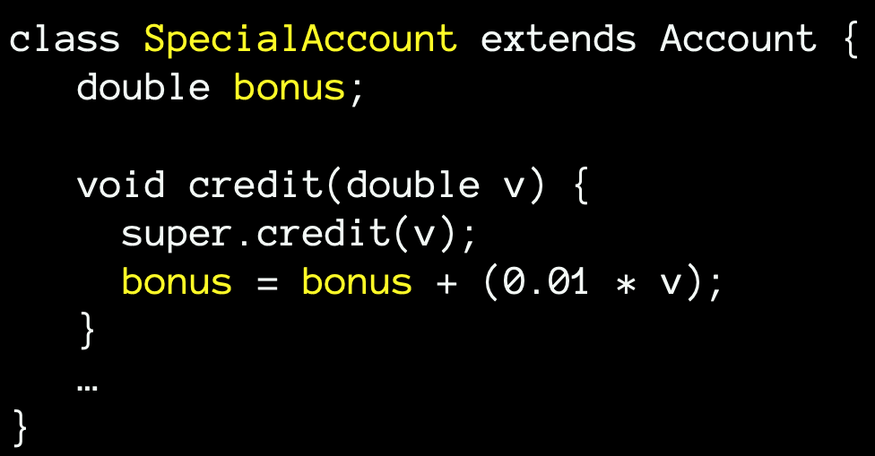
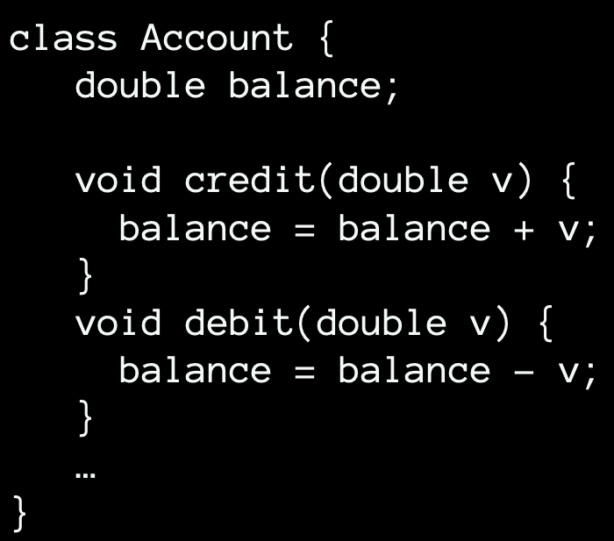
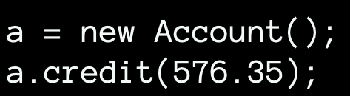
Open-closed: a module should be open for extension but closed for modification
open for extension
closed for modification

Slide 80
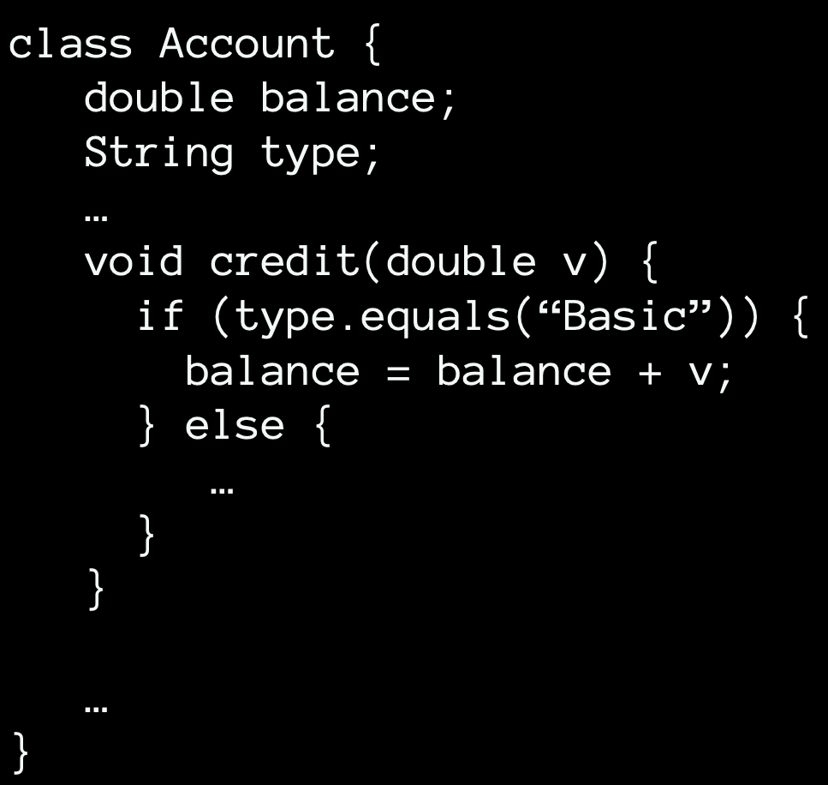
Extension requires modification: no use of sub typing
handling a new account type requires a new conditional

Slide 81
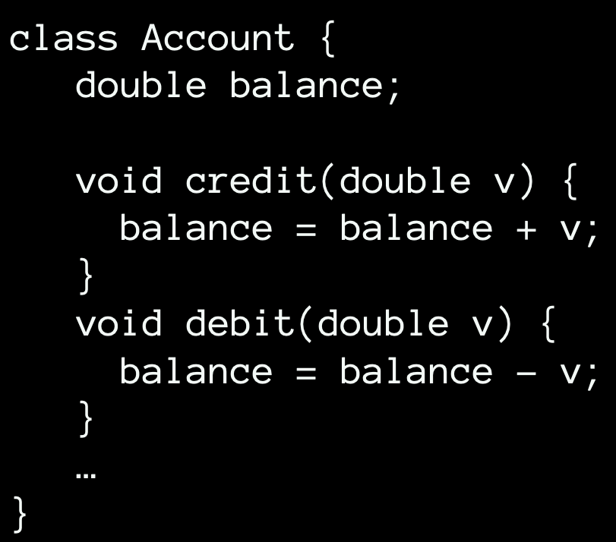
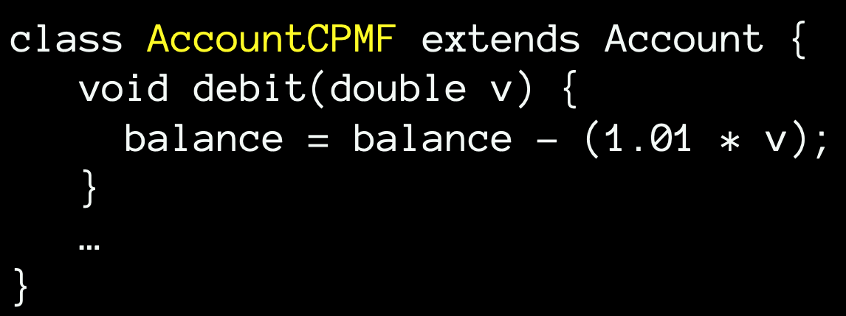
Liskov substitution: objects of subclasses should behave like those of superclasses if used via superclasses methods
clients can observe that objects of this class behave differently from objects of its superclass
call debit, and then print balance and you can observe the difference
breaks LSP!

Slide 82
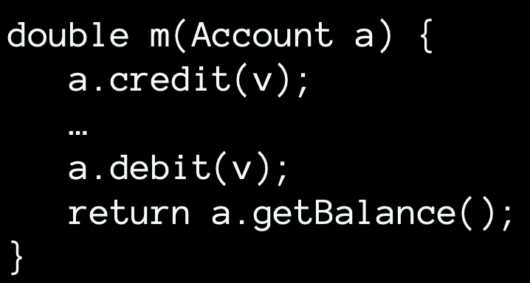
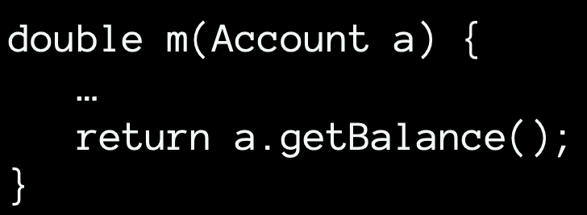
Breaking LSP reduces extensibility
possibly unsafe, non behavior-preserving modification, if LSP is not followed (demands analysis of all subclasses of Account)
safe, behavior-preserving modification, based only on the code of Account, if LSP is followed

Slide 83
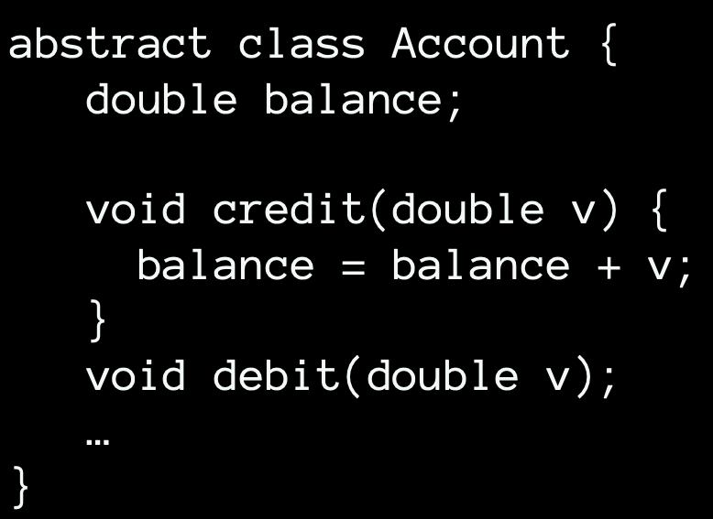
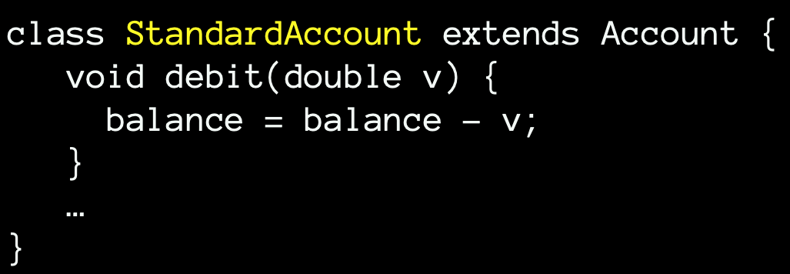
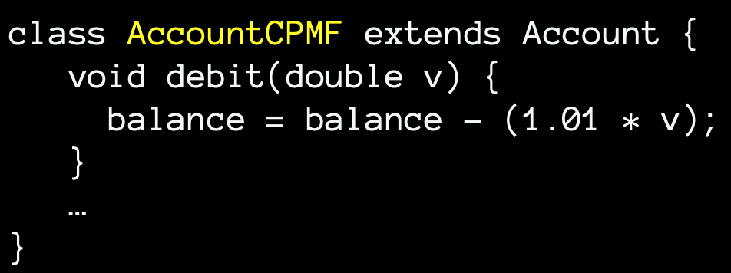
Supporting LSP by moving incompatible behavior from superclass to sibling

Slide 84

No misleading reasoning based on abstract methods
abstract method declaration specifies that we can’t expect a particular method behavior

Slide 85
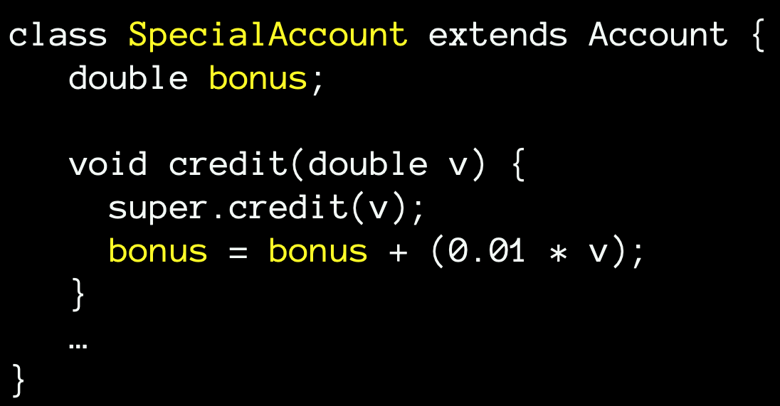
LSP doesn’t prevent a subclass from doing more (additional methods, fields, and behavior on those fields)
clients can only observe that objects of this class behave differently from objects of its superclass when getting bonus
call credit, and then print balance and you can’t observe the difference
satisfies LSP!

Slide 86

Interface segregation: client specific interfaces are better than one general purpose interface
different interfaces for different client demands
each client uses a different set of provided methods
Notes:
adicionar slide com um bom exemplo concreto!

Slide 87



Dependency injection: dependencies should be injected into a dependent object
internally created dependency

Slide 88




Injected dependency
externally created dependency
working with alternative dependency
changing dependency at run time
Notes:
adicionar slide com um bom exemplo concreto!

Slide 89

Demeter: a method of class A should only call methods of A or of the classes of A fields

Slide 90

Reducing dependencies, pushing them down
pulling complexity downwards

Slide 91

breaks Demeter
satisfies Demeter
Notes:
assumindo que quer criar sem validar, para permitir o preenchimento por partes…
caso contrário, o validate já deveria ser chamado pelo construtor de Student

Slide 92
Software and systems engineering
Paulo Borba
Informatics Center
Federal University of Pernambuco
pauloborba.cin.ufpe.br

Slide 93
Other design principles and values

Slide 94
Package cohesion principles
Classes that change together, belong together (common closure)
Classes that aren’t reused together should not be grouped together (common reuse)
The granule of reuse is the granule of release (release reuse equivalency)
Notes:
exemplo de projetos com pacotes para Model, View Controller, vs projeto com pacotes para cada slice MVC… modularização por tarefa (incorporar slides sobre isso)

Slide 95


packages
post slice
module
structure
established
by the kinds of classes
module
structure
established
by features
and tasks

Slide 96
Package coupling principles
The dependencies betwen packages must not form cycles (acyclic dependencies)
Depend in the direction of stability (stable dependencies)
Stable packages should be abstract packages (stable abstractions)
with interfaces or abstract classes
Notes:
Exercise: which principles have not been followed in your project?

Slide 97


alternative solution colapses packages into a single one
reducing package coupling by removing cyclic dependencies
Notes:
1+1 (o primeiro 1 indica que se ela mudar, pode afetar uma outra classe; o segundo indica que se uma outra classe mudar pode afetar esta)

Slide 98


Classes (modules) should be deep
signatures of public members (interface)
declarations of private members, bodies of public members
deep class
shallow class
Notes:
area reflete linhas de código

Slide 99
Cost per interface
small interface, large functionality (small cost per interface)
large interface, small functionality (large cost per interface)
pulling complexity downwards
Notes:
area reflete linhas de código

Slide 100
Abstraction is more important than size
design and code should rely on abstraction
large methods and classes are often associated with lack of abstraction
so the emphasis on small methods and classes
but what matters most is that methods and classes properly apply abstraction

Slide 101
Direction of control drives dependence direction
(for reusable code)
APIs, libraries, auxiliary classes: custom code calls reusable code
Frameworks: reusable code calls custom code (inversion of control)

Slide 102
Other rules
Rule of Modularity: Write simple parts connected by clean interfaces.
Rule of Clarity: Clarity is better than cleverness.
Rule of Composition: Design programs to be connected to other programs.
Rule of Separation: Separate policy from mechanism; separate interfaces from engines.
Rule of Simplicity: Design for simplicity; add complexity only where you must.
Rule of Parsimony: Write a big program only when it is clear by demonstration that nothing else will do.
Rule of Transparency: Design for visibility to make inspection and debugging easier.
Rule of Robustness: Robustness is the child of transparency and simplicity.
Rule of Representation: Fold knowledge into data so program logic can be stupid and robust.
The Art of Unix Programming, Eric Raymond

Slide 103
Other rules
Rule of Least Surprise: In interface design, always do the least surprising thing.
Rule of Silence: When a program has nothing surprising to say, it should say nothing.
Rule of Repair: When you must fail, fail noisily and as soon as possible.
Rule of Economy: Programmer time is expensive; conserve it in preference to machine time.
Rule of Generation: Avoid hand-hacking; write programs to write programs when you can.
Rule of Optimization: Prototype before polishing. Get it working before you optimize it.
Rule of Diversity: Distrust all claims for “one true way”.
Rule of Extensibility: Design for the future, because it will be here sooner than you think.
The Art of Unix Programming, Eric Raymond

Slide 104
https://xkcd.com/

Slide 105
Hands on exercises
Notes:
Indo de aluno por aluno, verificando o progresso, e registrando como comentário no assignment do classroom.
You can find assertions on the web that say
POST should be used to create a resource, and PUT should be used to modify one
PUT should be used to create a resource, and POST should be used to modify one
Neither is quite right.
Better is to choose between PUT and POST based on idempotence of the action.
PUT implies putting a resource - completely replacing whatever is available at the given URL with a different thing. By definition, a PUT is idempotent. Do it as many times as you like, and the result is the same. x=5 is idempotent. You can PUT a resource whether it previously exists, or not (eg, to Create, or to Update)!
POST updates a resource, adds a subsidiary resource, or causes a change. A POST is not idempotent, in the way that x++ is not idempotent.
By this argument, PUT is for creating when you know the URL of the thing you will create. POST can be used to create when you know the URL of the "factory" or manager for the category of things you want to create.
so:
POST /expense-report
or:
PUT /expense-report/10929

Slide 106
Design, implementation, and maintenance 2

Slide 107
Design, implementation, and maintenance 3
Notes:
tempo bom, rever lista de padrões? escolher mais interessante e cobrir no roteiro

Slide 108
Software and systems engineering
Paulo Borba
Informatics Center
Federal University of Pernambuco
pauloborba.cin.ufpe.br
Notes:
assumindo que já levantamos, documentamos e validamos alguns requisitos, precisamos agora implementar o sistema. mas antes de implementar, é importante entender…

Slide 109
Values and principles provide general direction, independent of specific problems

Slide 110
Patterns provide common solution structure for specific recurrent problems…
often applying values and principles

Slide 111
DDD already introduces a number of higher level modelling patterns
(entity, value object, repository, factory, service, etc.)

Slide 112
Pattern description
Context (situation giving rise to a problem)
Problem (recurring in such a context)
Forces (requirements for the solution)
Solution (proven, includes structure and dynamics)
Consequences (after applying the pattern)
Known uses (of the proven solution)

Slide 113
Facade design pattern
Context
system, library, or framework with a complex set of classes
Notes:
that demand us to initialize all of those objects, keep track of dependencies, execute methods in the correct order, and so on…

Slide 114

Problem
client tightly coupled to the subsystems
client has to know how to initialize, combine and coordinate subsystems
Notes:
directly following the low coupling principle…

Slide 115

Solution (structure)
provides simplified interface
facade class initializes, combines and coordinates subsystems, hiding such details from clients, and avoiding duplication
Notes:
Facade and Mediator have similar jobs: they try to organize collaboration between lots of tightly coupled classes.
Facade defines a simplified interface to a subsystem of objects. The subsystem itself is unaware of the facade. Objects within the subsystem can communicate directly.
Mediator centralizes communication between components of the system. The components only know about the mediator object and don’t communicate directly.

Slide 116
Mediator
Notes:
melhor logo apos facade

Slide 117

Problem
bidirectional dependencies, contrasting with facade

Slide 118

Solution

Slide 119


Slide 120
Software and systems engineering
Paulo Borba
Informatics Center
Federal University of Pernambuco
pauloborba.cin.ufpe.br
Notes:
assumindo que já levantamos, documentamos e validamos alguns requisitos, precisamos agora implementar o sistema. mas antes de implementar, é importante entender…

Slide 121
Applying the abstract factory design pattern

Slide 122


Professors and courses

Slide 123

Java POI
Java APIs Java for manipulating “OLE 2 Compound Document” files, such as xls e doc:
HSSF (Horrible Spreadsheet Format)
HDF (Horrible Document Format)
HPSF (Horrible Property Set Format)

Slide 124
Reduce coupling to library dependencies is often a good idea
Allocation object creation is not simple, and depends on spreadsheet format

Slide 125


Factory pattern for using POI
reduced coupling: isolated and hidden object creation complexity and dependencies

Slide 126

Abstract factory pattern
supporting alternative creation logic and dependencies

Slide 127

Further abstracting the created object

Slide 128

A similar design might be adequate for StudentListImport

Slide 129
Software and systems engineering
Paulo Borba
Informatics Center
Federal University of Pernambuco
pauloborba.cin.ufpe.br

Slide 130
Decorator
Context
different clients or situations demand additional behavior, and combinations

Slide 131
Logging and cyphering emails, but not for all

Slide 132

Problem
multiple inheritance, not always available
combinatorial solution, quickly grows with the number of alternatives

Slide 133

Problem
mixes concerns
lack of cohesion, likely compromises readability
fixed combination order

Slide 134



Solution
composition, decorated field
inheritance

Slide 135


combination can be dynamically changed
supports multiple combinations with the same class structure
Notes:
falar sobre encadeamento de news

Slide 136
Not often worth to decorate a single (stateless, simple) functionality in a language that supports high order functions

Slide 137
Software and systems engineering
Paulo Borba
Informatics Center
Federal University of Pernambuco
pauloborba.cin.ufpe.br

Slide 138
Chain of responsibility
Similar structure to decorator
Different intent
Handlers versus decoratos
Handlers can stop the execution chain
Handlers can execute arbitrary operations (not just additions)

Slide 139

Proxy
different intent and possibilities; limited combination possibilities
similar structure to decorator
Notes:
exemplo de acesso local e remoto a um serviço, os proxies são opções alternativas (nao podem ser combinadas), não complementares como decorators e chains
não 100% esse exemplo acima, melhor dizer que o proxy faz autenticação remota, e depois envia a requisição. se serviço de email fosse local poderia dispensar autenticacao

Slide 140

Adapter, wrapper
similar structure to proxies, different interfaces

Slide 141

Client is supposed to conform to a specific interface

Slide 142
Software and systems engineering
Paulo Borba
Informatics Center
Federal University of Pernambuco
pauloborba.cin.ufpe.br

Slide 143
Software and systems engineering
Paulo Borba
Informatics Center
Federal University of Pernambuco
pauloborba.cin.ufpe.br

Slide 144
Strategy (and command)

Slide 145


Problem
fixed or non modular way for computing grades

Slide 146


Solution
variability of single operation
high order languages

Slide 147

Solution
variability of many operations

Slide 148

Template method
template,
common code
variablecode
Notes:
uso conjunto de padroes.
poderia ser separado

Slide 149
Bridge

Slide 150


Problem
abstraction implemented in a fixed way

Slide 151

Solution
bridge between abstraction and implementation
similar structure to strategy, but different intent
Notes:
explicar porque students sumiu da figura: porque baixou o nível da figura, agora é um retrato do código ao invés de modelo mais abstrato

Slide 152

Solution
if abstraction adds little to the implementation interface

Slide 153
State

Slide 154


Problem
changing course implies on changing identity object

Slide 155


Solution
state
changing course implies on changing field of identity object

Slide 156

Composite
similar structure to decorator, but focus on representing data

Slide 157

Often more complex structures

Slide 158




Slide 159

Abstract syntax tree (AST)

Slide 160

Interpreter
interpreter method

Slide 161

Visitor
each visitor provides different node specific ofunctionality
reusable traversal logic

Slide 162



Slide 163


Slide 164
Flyweight

Slide 165


Problem
a different, replicated, course object for each student
creates student and course objects from provided data

Slide 166


Solution
a shared course object for students from the same course
flyweight
creates or recovers course objects according to data

Slide 167
Other patterns
Command (better with function, if single function)

Slide 168
Strategy
Analyze change request
Any pattern for the given context?
New solution based on values and principles?
Apply appropriate pattern or principles
Check whether new functionality breaks existing tests

Slide 169
For now, focus on bad design smells, related to classes and their relationships
Later we will focus on bad code smells, related to method implementations

Slide 170
Applies for testing code too!

Slide 171
Checklist
Design and implementation conforms to discussed principles and patterns

Slide 172
Take notes, now!

Slide 173
Hands on exercises
Notes:
Indo de aluno por aluno, verificando o progresso, e registrando como comentário no assignment do classroom.
You can find assertions on the web that say
POST should be used to create a resource, and PUT should be used to modify one
PUT should be used to create a resource, and POST should be used to modify one
Neither is quite right.
Better is to choose between PUT and POST based on idempotence of the action.
PUT implies putting a resource - completely replacing whatever is available at the given URL with a different thing. By definition, a PUT is idempotent. Do it as many times as you like, and the result is the same. x=5 is idempotent. You can PUT a resource whether it previously exists, or not (eg, to Create, or to Update)!
POST updates a resource, adds a subsidiary resource, or causes a change. A POST is not idempotent, in the way that x++ is not idempotent.
By this argument, PUT is for creating when you know the URL of the thing you will create. POST can be used to create when you know the URL of the "factory" or manager for the category of things you want to create.
so:
POST /expense-report
or:
PUT /expense-report/10929

Slide 174
Design, implementation, and maintenance 3

Slide 175
Design, implementation, and maintenance 4

Slide 176
Hands on exercises
Notes:
Indo de aluno por aluno, verificando o progresso, e registrando como comentário no assignment do classroom.
You can find assertions on the web that say
POST should be used to create a resource, and PUT should be used to modify one
PUT should be used to create a resource, and POST should be used to modify one
Neither is quite right.
Better is to choose between PUT and POST based on idempotence of the action.
PUT implies putting a resource - completely replacing whatever is available at the given URL with a different thing. By definition, a PUT is idempotent. Do it as many times as you like, and the result is the same. x=5 is idempotent. You can PUT a resource whether it previously exists, or not (eg, to Create, or to Update)!
POST updates a resource, adds a subsidiary resource, or causes a change. A POST is not idempotent, in the way that x++ is not idempotent.
By this argument, PUT is for creating when you know the URL of the thing you will create. POST can be used to create when you know the URL of the "factory" or manager for the category of things you want to create.
so:
POST /expense-report
or:
PUT /expense-report/10929

Slide 177
Design, implementation, and maintenance 4

Slide 178
Design, implementation and evolution research at CIn
Software product lines and evolution: Leopoldo, Paulo
Formal specification methods: Augusto, Alexandre Mota, Juliano, Henrique, Márcio
Concurrent systems and green design: Fernando Castor
Distributed systems architecture: Vinicius, Kiev

Slide 179
To do after class
Answer questionnaire (check classroom assignment), study correct answers
Finish exercise (check classroom assignment), study correct answers
Read, again, chapters 8 and 11 in the textbook
Evaluate classes (check classroom assignment)
Study questions from previous exams

Slide 180
To do after class,
optional
Estudar material sobre princípios de projeto
Estudar princípios de codificação no Capítulo 3 do livro Implementation patterns, Kent Beck, 2008 (slides úteis para ter uma visão geral do livro)
Navegar pelo catálogo de padrões

Slide 181
Questions from previous exams
Descreva o princípio “Dependency Injection”. Explique as vantagens de seguir este princípio.
Descreva o objetivo do padrão de projeto “Adapter”, e desenhe um diagrama de classes representando a sua estrutura.
O princípio “Acyclic dependencies”estabelece que “The dependencies between packages must not form cycles”. Explique as vantagens de seguir esse princípio.
Desenhe um diagrama de classes que ilustre o padrão de projeto “Decorator”, e explique as suas vantagens.

Slide 182
Questions from previous exams
Descreva o princípio “Single Responsibility Principle”. Explique as vantagens de seguir este princípio.
Descreva o princípio de projeto “Demeter”. Explique as vantagens de seguir este princípio.
Desenhe um diagrama de classes que ilustre o padrão de projeto “Abstract Factory”, e explique que problema ele resolve.

Slide 183
Software and systems engineering
Paulo Borba
Informatics Center
Federal University of Pernambuco
phmb@cin.ufpe.br ◈ twitter.com/pauloborba

